Slide 1
Data Mining
Practical Machine Learning Tools and Techniques
Slides for Chapter 6 of Data Mining by I. H. Witten, E. Frank and
M. A. Hall

Slide 2
Implementation:
Real machine learning schemes
Decision trees
  From ID3 to C4.5 (pruning, numeric attributes, ...)
Classification rules
  From PRISM to RIPPER and PART (pruning, numeric data, …)
Association Rules
  Frequent-pattern trees
Extending linear models
  Support vector machines and neural networks
Instance-based learning
  Pruning examples, generalized exemplars, distance functions

Slide 3
Implementation:
Real machine learning schemes
Numeric prediction
  Regression/model trees, locally weighted regression
Bayesian networks
  Learning and prediction, fast data structures for learning
Clustering: hierarchical, incremental, probabilistic
  Hierarchical, incremental, probabilistic, Bayesian
Semisupervised learning
  Clustering for classification, co-training
Multi-instance learning
  Converting to single-instance, upgrading learning algorithms, dedicated multi-instance methods

Slide 4
Industrial-strength algorithms
For an algorithm to be useful in a wide range of real-world applications it must:
  Permit numeric attributes
  Allow missing values
  Be robust in the presence of noise
  Be able to approximate arbitrary concept descriptions (at least in principle)
Basic schemes need to be extended to fulfill these requirements

Slide 5
Decision trees
Extending ID3:
  to permit numeric attributes: straightforward
  to deal sensibly with missing values: trickier
  stability for noisy data:
  requires pruning mechanism
End result: C4.5 (Quinlan)
  Best-known and (probably) most widely-used learning algorithm
  Commercial successor: C5.0

Slide 6
Numeric attributes
Standard method: binary splits
  E.g. temp < 45
Unlike nominal attributes,
every attribute has many possible split points
Solution is straightforward extension:
  Evaluate info gain (or other measure)
  for every possible split point of attribute
  Choose “best” split point
  Info gain for best split point is info gain for attribute
Computationally more demanding

Slide 7
Weather data (again!)
Outlook
Outlook
Outlook
Temperature
Temperature
Temperature
Humidity
Humidity
Humidity
Windy
Windy
Windy
Play
Play
Play
Sunny
Sunny
Sunny
Hot
Hot
Hot
High
High
High
False
False
False
No
No
No
Sunny
Sunny
Sunny
Hot
Hot
Hot
High
High
High
True
True
True
No
No
No
Overcast
Overcast
Overcast
Hot
Hot
Hot
High
High
High
False
False
False
Yes
Yes
Yes
Rainy
Rainy
Rainy
Mild
Mild
Mild
Normal
Normal
High
False
False
False
Yes
Yes
Yes
…
…
…
…
…
…
…
…
…
…
…
…
…
…
…
…
…
Rainy
…
…
Cool
…
…
Normal
…
…
False
…
…
Yes
…
…
Rainy
…
…
Cool
…
…
Normal
…
…
True
…
…
No
…
…
…
…
…
…
…
…
…
…
…
…
…
…
…
If outlook = sunny and humidity = high then play = no
If outlook = rainy and windy = true then play = no
If outlook = overcast then play = yes
If humidity = normal then play = yes
If none of the above then play = yes

Slide 8
Weather data (again!)
Outlook
Outlook
Outlook
Temperature
Temperature
Temperature
Humidity
Humidity
Humidity
Windy
Windy
Windy
Play
Play
Play
Sunny
Sunny
Sunny
Hot
Hot
Hot
High
High
High
False
False
False
No
No
No
Sunny
Sunny
Sunny
Hot
Hot
Hot
Outlook
Outlook
Outlook
High
High
High
Temperature
Temperature
Temperature
True
True
True
Humidity
Humidity
Humidity
No
No
No
Windy
Windy
Windy
Play
Play
Play
Overcast
Overcast
Overcast
Hot
Hot
Hot
Sunny
Sunny
Sunny
High
High
High
Hot
Hot
85
False
False
False
High
High
85
Yes
Yes
Yes
False
False
False
No
No
No
Sunny
Sunny
Sunny
Hot
Hot
80
High
High
90
True
True
True
No
No
Rainy
No
Rainy
Rainy
Mild
Mild
Mild
Normal
Normal
High
False
False
False
Yes
Yes
Yes
…
…
…
…
…
…
Overcast
Overcast
Overcast
…
…
…
Hot
Hot
83
…
…
…
High
High
86
…
…
…
False
False
False
Yes
Yes
…
Yes
…
Rainy
…
…
Cool
…
…
Normal
…
…
False
…
…
Yes
…
…
Rainy
…
…
Cool
Rainy
Rainy
Rainy
…
…
Normal
Mild
Mild
70
…
…
True
Normal
Normal
96
…
…
No
False
False
False
Yes
Yes
Yes
…
…
…
…
…
…
…
…
…
…
…
…
…
…
…
…
…
…
…
…
…
…
…
Rainy
…
…
…
…
…
68
…
…
…
…
…
80
…
…
…
…
…
False
…
…
Yes
…
…
Rainy
…
…
65
…
…
70
…
…
True
…
…
No
…
…
…
…
…
…
…
…
…
…
…
…
…
…
…
If outlook = sunny and humidity = high then play = no
If outlook = rainy and windy = true then play = no
If outlook = overcast then play = yes
If humidity = normal then play = yes
If none of the above then play = yes
If outlook = sunny and humidity > 83 then play = no
If outlook = rainy and windy = true then play = no
If outlook = overcast then play = yes
If humidity < 85 then play = no
If none of the above then play = yes

Slide 9
Example
Split on temperature attribute:
  E.g. temperature < 71.5: yes/4, no/2
  temperature ≥ 71.5: yes/5, no/3
  Info([4,2],[5,3])
  = 6/14 info([4,2]) + 8/14 info([5,3])
  = 0.939 bits
Place split points halfway between values
Can evaluate all split points in one pass!
64 65 68 69 70 71 72 72 75 75 80 81 83 85
Yes No Yes Yes Yes No No Yes Yes Yes No Yes Yes No

Slide 10
Can avoid repeated sorting
Sort instances by the values of the numeric attribute
  Time complexity for sorting: O (n log n)
Does this have to be repeated at each node of the tree?
No! Sort order for children can be derived from sort order for parent
  Time complexity of derivation: O (n)
  Drawback: need to create and store an array of sorted indices for each numeric attribute

Slide 11
Binary vs multiway splits
Splitting (multi-way) on a nominal attribute exhausts all information in that attribute
  Nominal attribute is tested (at most) once on any path in the tree
Not so for binary splits on numeric attributes!
  Numeric attribute may be tested several times along a path in the tree
Disadvantage: tree is hard to read
Remedy:
  pre-discretize numeric attributes, or
  use multi-way splits instead of binary ones

Slide 12
Computing multi-way splits
Simple and efficient way of generating multi-way splits: greedy algorithm
Dynamic programming can find optimum multi-way split in O (n²) time
  imp (k, i, j ) is the impurity of the best split of values x_{i} … x_{j} into k sub-intervals
  imp (k, 1, i ) =
  min_{0<j <i} imp (k–1, 1, j ) + imp (1, j+1, i )
  imp (k, 1, N ) gives us the best k-way split
In practice, greedy algorithm works as well

Slide 13
Missing values
Split instances with missing values into pieces
  A piece going down a branch receives a weight proportional to the popularity of the branch
  weights sum to 1
Info gain works with fractional instances
  use sums of weights instead of counts
During classification, split the instance into pieces in the same way
  Merge probability distribution using weights

Slide 14
Pruning
Prevent overfitting to noise in the data
“Prune” the decision tree
Two strategies:
  Postpruning
  take a fully-grown decision tree and discard unreliable parts
  Prepruning
  stop growing a branch when information becomes unreliable
Postpruning preferred in practice—prepruning can “stop early”

Slide 15
Prepruning
Based on statistical significance test
  Stop growing the tree when there is no statistically significant association between any attribute and the class at a particular node
Most popular test: chi-squared test
ID3 used chi-squared test in addition to information gain
  Only statistically significant attributes were allowed to be selected by information gain procedure

Slide 16
Early stopping
a
b
class
1
0
0
0
2
0
1
1
3
1
0
1
Pre-pruning may stop the growth
process prematurely: early stopping
Classic example: XOR/Parity-problem
  No individual attribute exhibits any significant association to the class
  Structure is only visible in fully expanded tree
  Prepruning won’t expand the root node
But: XOR-type problems rare in practice
And: prepruning faster than postpruning
4
1
1
0

Slide 17
Postpruning
First, build full tree
Then, prune it
  Fully-grown tree shows all attribute interactions
Problem: some subtrees might be due to chance effects
Two pruning operations:
  Subtree replacement
  Subtree raising
Possible strategies:
  error estimation
  significance testing
  MDL principle

Slide 18
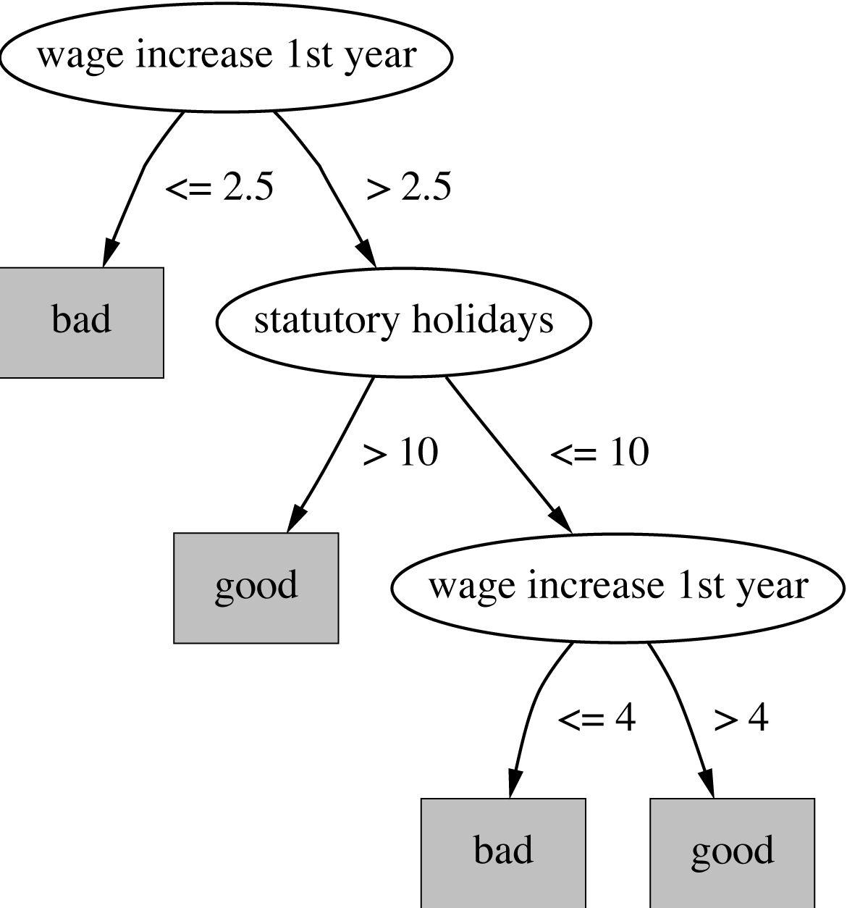
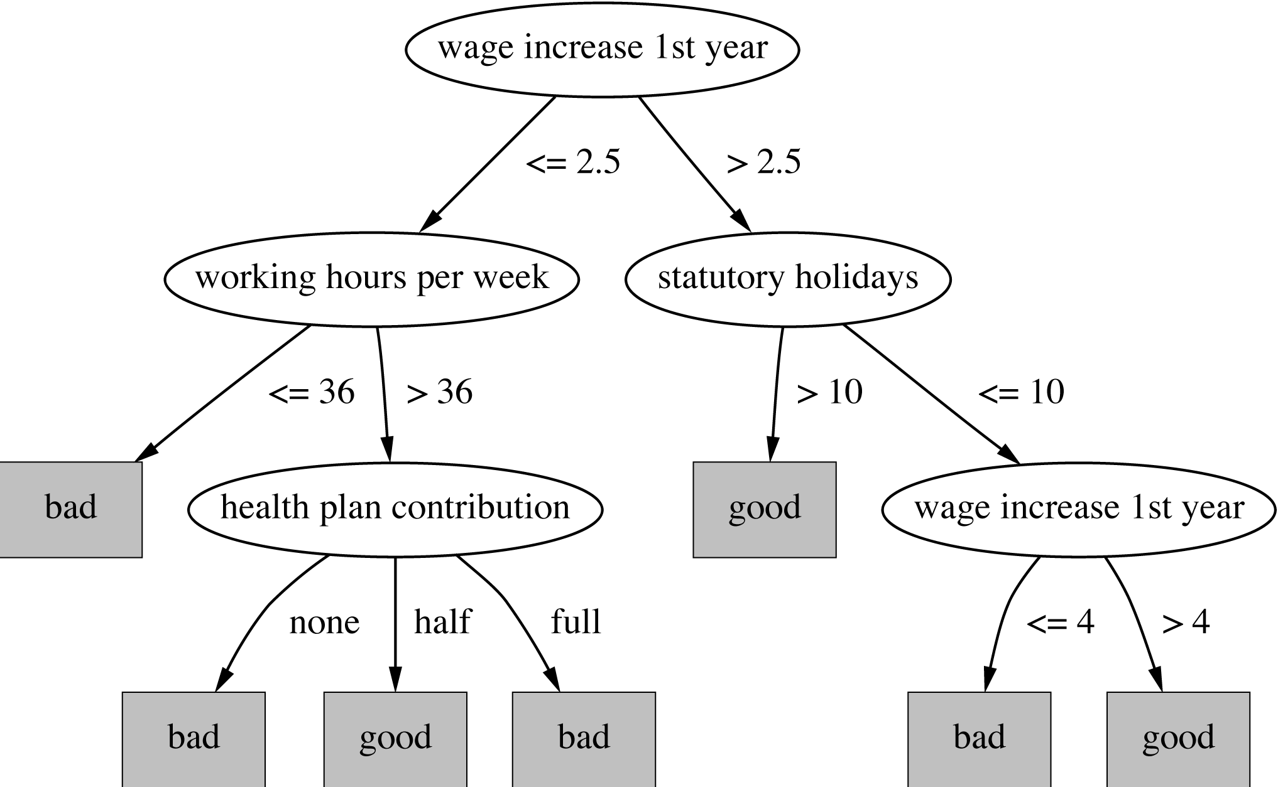
Subtree replacement
Bottom-up
Consider replacing a tree only after considering all its subtrees

Slide 19
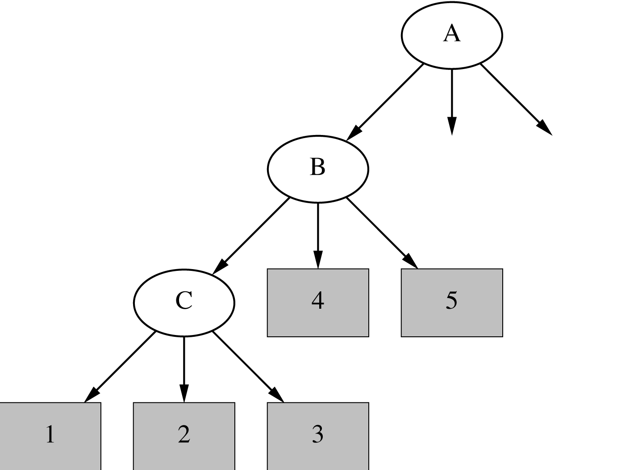
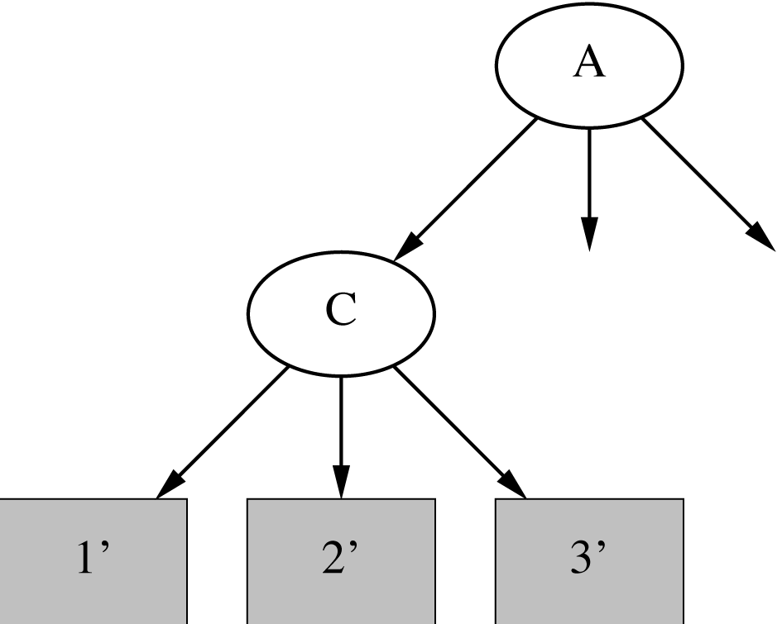
Subtree raising
Delete node
Redistribute instances
Slower than subtree replacement
(Worthwhile?)

Slide 20
Estimating error rates
Prune only if it does not increase the estimated error
Error on the training data is NOT a useful estimator
(would result in almost no pruning)
Use hold-out set for pruning
(“reduced-error pruning”)
C4.5’s method
  Derive confidence interval from training data
  Use a heuristic limit, derived from this, for pruning
  Standard Bernoulli-process-based method
  Shaky statistical assumptions (based on training data)

Slide 21
C4.5’s method
Error estimate for subtree is weighted sum of error estimates for all its leaves
Error estimate for a node:
If c = 25% then z = 0.69 (from normal distribution)
f is the error on the training data
N is the number of instances covered by the leaf

Slide 22
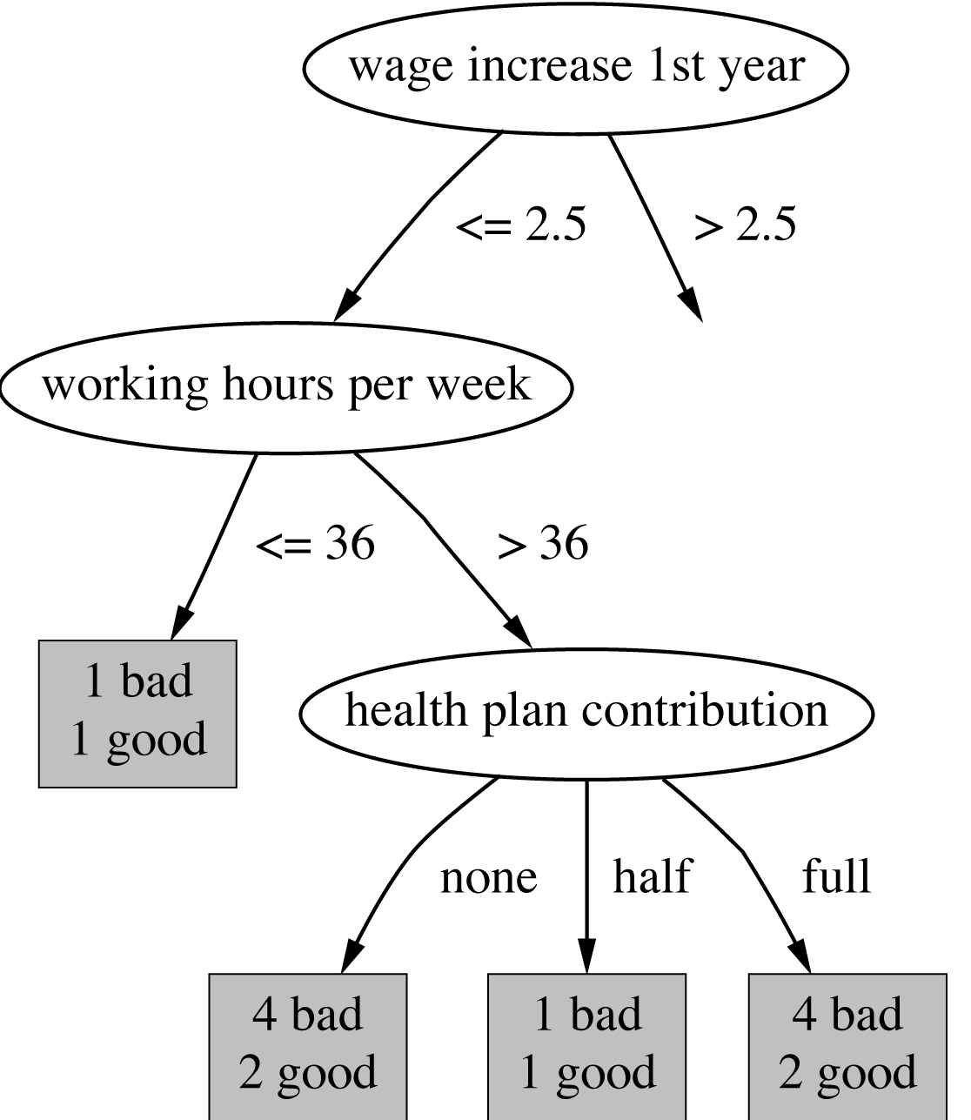
Example
f = 5/14
e = 0.46
e < 0.51
so prune!
f=0.33 e=0.47
f=0.5 e=0.72
f=0.33 e=0.47
Combined using ratios 6:2:6 gives 0.51

Slide 23
Complexity of tree induction
Assume
  m attributes
  n training instances
  tree depth O (log n)
Building a tree O (m n log n)
Subtree replacement O (n)
Subtree raising O (n (log n)²)
  Every instance may have to be redistributed at every node between its leaf and the root
  Cost for redistribution (on average): O (log n)
Total cost: O (m n log n) + O (n (log n)²)

Slide 24
From trees to rules
Simple way: one rule for each leaf
C4.5rules: greedily prune conditions from each rule if this reduces its estimated error
  Can produce duplicate rules
  Check for this at the end
Then
  look at each class in turn
  consider the rules for that class
  find a “good” subset (guided by MDL)
Then rank the subsets to avoid conflicts
Finally, remove rules (greedily) if this decreases error on the training data

Slide 25
C4.5: choices and options
C4.5rules slow for large and noisy datasets
Commercial version C5.0rules uses a different technique
  Much faster and a bit more accurate
C4.5 has two parameters
  Confidence value (default 25%):
  lower values incur heavier pruning
  Minimum number of instances in the two most popular branches (default 2)

Slide 26
Cost-complexity pruning
C4.5's postpruning often does not prune enough
  Tree size continues to grow when more instances are added even if performance on independent data does not improve
  Very fast and popular in practice
Can be worthwhile in some cases to strive for a more compact tree
  At the expense of more computational effort
  Cost-complexity pruning method from the CART (Classification and Regression Trees) learning system

Slide 27
Cost-complexity pruning
Basic idea:
  First prune subtrees that, relative to their size, lead to the smallest increase in error on the training data
  Increase in error (α) – average error increase per leaf of subtree
  Pruning generates a sequence of successively smaller trees
    Each candidate tree in the sequence corresponds to one particular threshold value, αi
  Which tree to chose as the final model?
    Use either a hold-out set or cross-validation to estimate the error of each

Slide 28
Discussion
TDIDT: Top-Down Induction of Decision Trees
The most extensively studied method of machine learning used in data mining
Different criteria for attribute/test selection rarely make a large difference
Different pruning methods mainly change the size of the resulting pruned tree
C4.5 builds univariate decision trees
Some TDITDT systems can build multivariate trees (e.g. CART)

Slide 29
Classification rules
Common procedure: separate-and-conquer
Differences:
  Search method (e.g. greedy, beam search, ...)
  Test selection criteria (e.g. accuracy, ...)
  Pruning method (e.g. MDL, hold-out set, ...)
  Stopping criterion (e.g. minimum accuracy)
  Post-processing step
Also: Decision list
vs.
one rule set for each class

Slide 30
Test selection criteria
Basic covering algorithm:
  keep adding conditions to a rule to improve its accuracy
  Add the condition that improves accuracy the most
Measure 1: p/t
  t total instances covered by rule
  p number of these that are positive
  Produce rules that don’t cover negative instances,
  as quickly as possible
  May produce rules with very small coverage
  —special cases or noise?
Measure 2: Information gain p (log(p/t) – log(P/T))
  P and T the positive and total numbers before the new condition was added
  Information gain emphasizes positive rather than negative instances
These interact with the pruning mechanism used

Slide 31
Missing values, numeric attributes
Common treatment of missing values:
for any test, they fail
  Algorithm must either
    use other tests to separate out positive instances
    leave them uncovered until later in the process
In some cases it’s better to treat “missing” as a separate value
Numeric attributes are treated just like they are in decision trees

Slide 32
Pruning rules
Two main strategies:
  Incremental pruning
  Global pruning
Other difference: pruning criterion
  Error on hold-out set (reduced-error pruning)
  Statistical significance
  MDL principle
Also: post-pruning vs. pre-pruning

Slide 33
Using a pruning set
For statistical validity, must evaluate measure on data not used for training:
  This requires a growing set and a pruning set
Reduced-error pruning :
build full rule set and then prune it
Incremental reduced-error pruning : simplify each rule as soon as it is built
  Can re-split data after rule has been pruned
Stratification advantageous

Slide 34
Incremental reduced-error pruning
Initialize E to the instance set
Until E is empty do
Split E into Grow and Prune in the ratio 2:1
For each class C for which Grow contains an instance
Use basic covering algorithm to create best perfect rule
for C
Calculate w(R): worth of rule on Prune
and w(R-): worth of rule with final condition
omitted
If w(R-) > w(R), prune rule and repeat previous step
From the rules for the different classes, select the one
that’s worth most (i.e. with largest w(R))
Print the rule
Remove the instances covered by rule from E
Continue

Slide 35
Measures used in IREP
[p + (N – n)] / T
  (N is total number of negatives)
  Counterintuitive:
    p = 2000 and n = 1000 vs. p = 1000 and n = 1
Success rate p / t
  Problem: p = 1 and t = 1
  vs. p = 1000 and t = 1001
(p – n) / t
  Same effect as success rate because it equals 2p/t – 1
Seems hard to find a simple measure of a rule’s worth that corresponds with intuition

Slide 36
Variations
Generating rules for classes in order
  Start with the smallest class
  Leave the largest class covered by the default rule
Stopping criterion
  Stop rule production if accuracy becomes too low
Rule learner RIPPER:
  Uses MDL-based stopping criterion
  Employs post-processing step to modify rules guided by MDL criterion

Slide 37
Using global optimization
RIPPER: Repeated Incremental Pruning to Produce Error Reduction (does global optimization in an efficient way)
Classes are processed in order of increasing size
Initial rule set for each class is generated using IREP
An MDL-based stopping condition is used
  DL: bits needs to send examples wrt set of rules, bits needed to send k tests, and bits for k
Once a rule set has been produced for each class, each rule is re-considered and two variants are produced
  One is an extended version, one is grown from scratch
  Chooses among three candidates according to DL
Final clean-up step greedily deletes rules to minimize DL

Slide 38
PART
Avoids global optimization step used in C4.5rules and RIPPER
Generates an unrestricted decision list using basic separate-and-conquer procedure
Builds a partial decision tree to obtain a rule
  A rule is only pruned if all its implications are known
  Prevents hasty generalization
Uses C4.5’s procedures to build a tree

Slide 39
Building a partial tree
Expand-subset (S):
Choose test T and use it to split set of examples
into subsets
Sort subsets into increasing order of average
entropy
while
there is a subset X not yet been expanded
AND all subsets expanded so far are leaves
expand-subset(X)
if
all subsets expanded are leaves
AND estimated error for subtree
≥ estimated error for node
undo expansion into subsets and make node a leaf

Slide 40
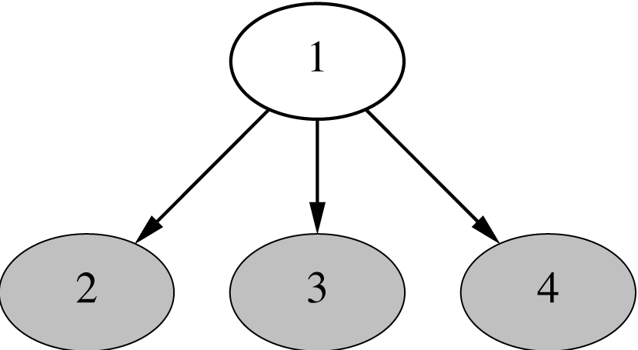
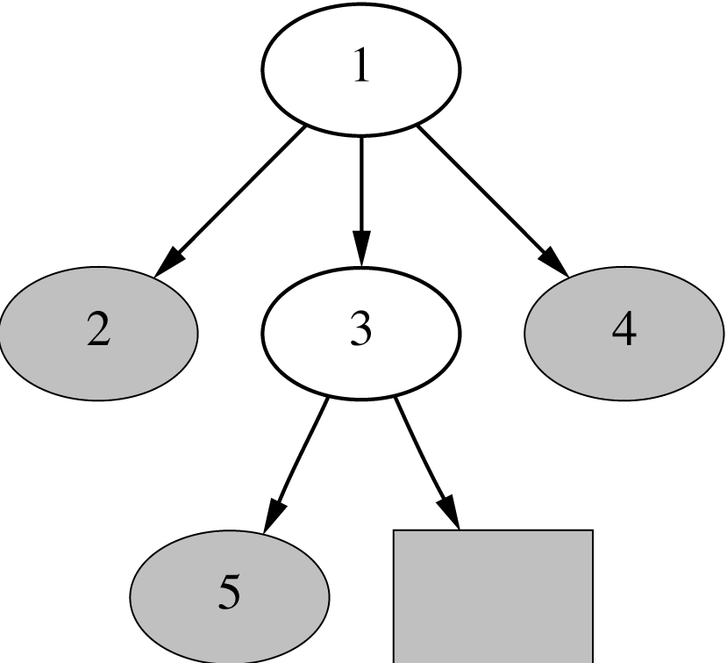
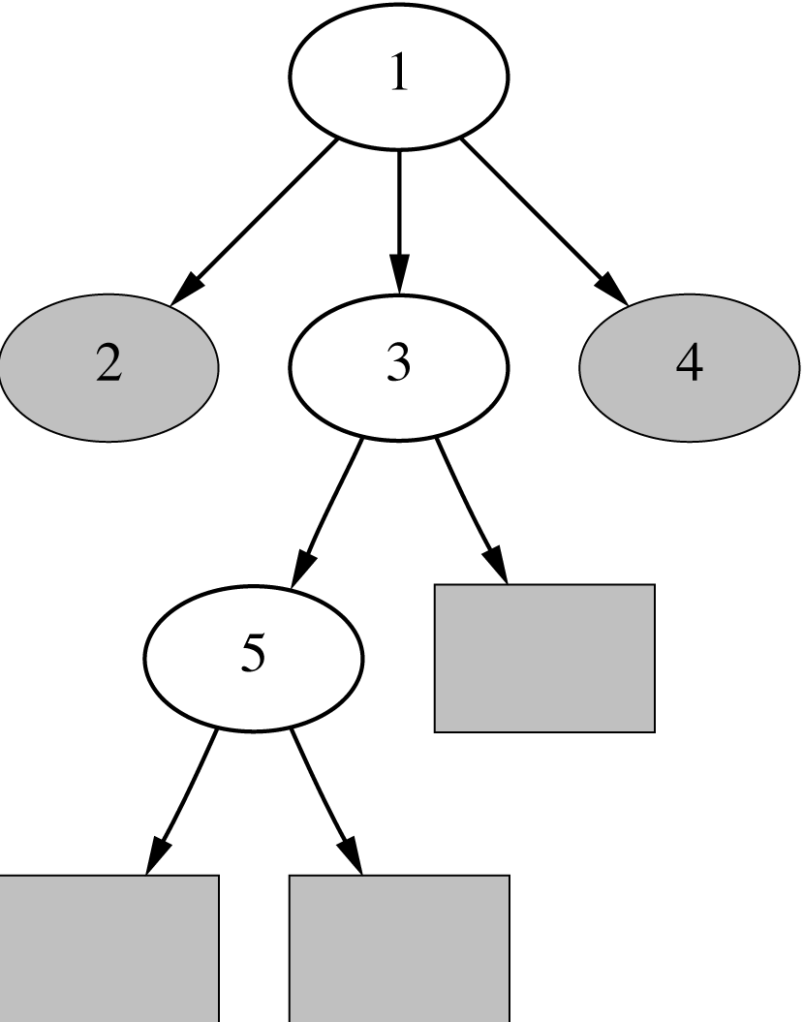
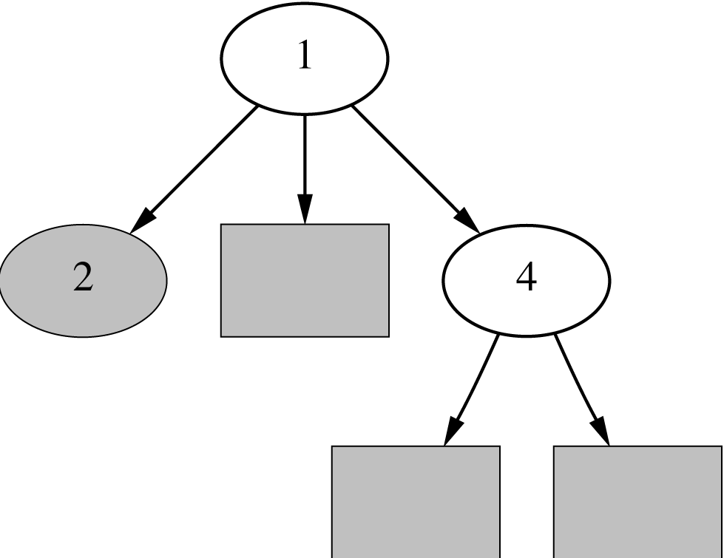
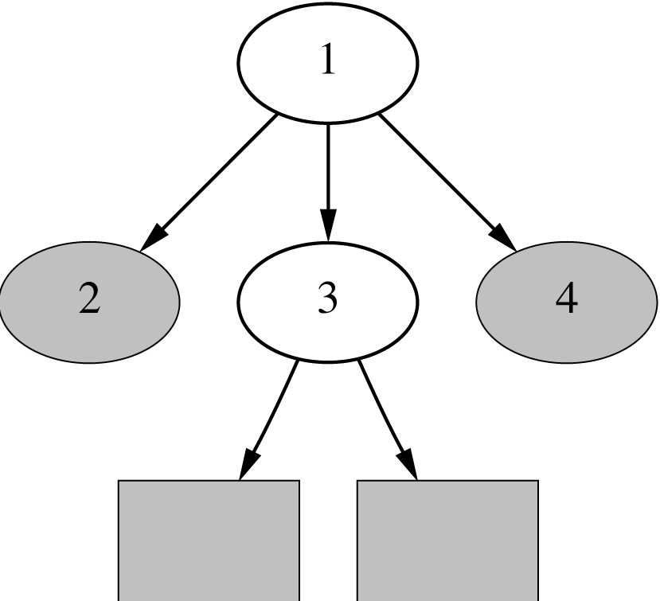
Example

Slide 41
Notes on PART
Make leaf with maximum coverage into a rule
Treat missing values just as C4.5 does
  I.e. split instance into pieces
Time taken to generate a rule:
  Worst case: same as for building a pruned tree
    Occurs when data is noisy
  Best case: same as for building a single rule
    Occurs when data is noise free

Slide 42
Rules with exceptions
Given: a way of generating a single good rule
Then it’s easy to generate rules with exceptions
Select default class for top-level rule
Generate a good rule for one of the remaining classes
Apply this method recursively to the two subsets produced by the rule
(I.e. instances that are covered/not covered)

Slide 43
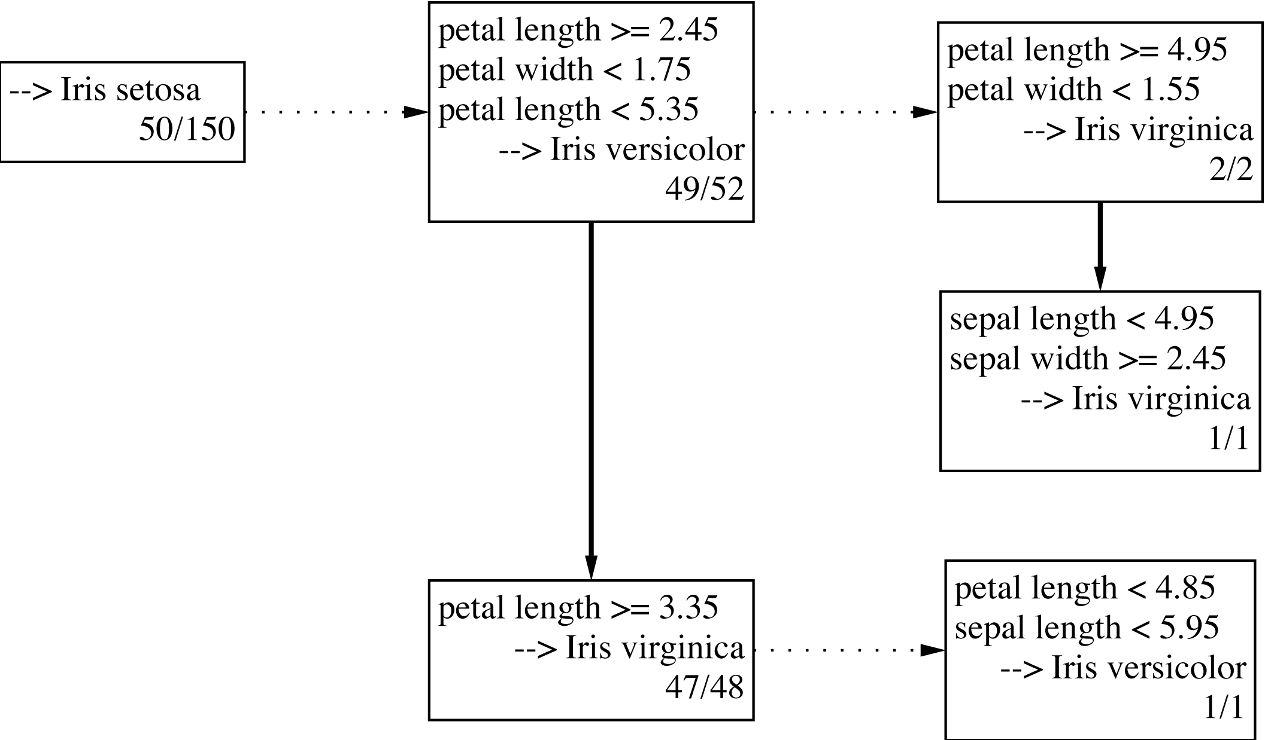
Iris data example
Exceptions are represented as
Dotted paths, alternatives as solid ones.

Slide 44
Association rules
Apriori algorithm finds frequent item sets via a generate-and-test methodology
  Successively longer item sets are formed from shorter ones
  Each different size of candidate item set requires a full scan of the data
  Combinatorial nature of generation process is costly – particularly if there are many item sets, or item sets are large
Appropriate data structures can help
FP-growth employs an extended prefix tree (FP-tree)

Slide 45
FP-growth
FP-growth uses a Frequent Pattern Tree (FP-tree) to store a compressed version of the data
Only two passes are required to map the data into an FP-tree
The tree is then processed recursively to “grow” large item sets directly
  Avoids generating and testing candidate item sets against the entire database

Slide 46
Building a frequent pattern tree
First pass over the data – count the number times individual items occur
Second pass over the data – before inserting each instance into the FP-tree, sort its items in descending order of their frequency of occurrence, as found in step 1
  Individual items that do not meet the minimum support are not inserted into the tree
  Hopefully many instances will share items that occur frequently individually, resulting in a high degree of compression close to the root of the tree

Slide 47
An example using the weather data
Frequency of individual items (minimum support = 6)
play = yes 9
windy = false 8
humidity = normal 7
humidity = high 7
windy = true 6
temperature = mild 6
play = no 5
outlook = sunny 5
outlook = rainy 5
temperature = hot 4
temperature = cool 4
outlook = overcast 4

Slide 48
An example using the weather data
Instances with items sorted
1 windy=false, humidity=high, play=no, outlook=sunny, temperature=hot
2 humidity=high, windy=true, play=no, outlook=sunny, temperature=hot
3 play=yes, windy=false, humidity=high, temperature=hot, outlook=overcast
4 play=yes, windy=false, humidity=high, temperature=mild, outlook=rainy
.
.
.
14 humidity=high, windy=true, temperature=mild, play=no, outlook=rainy
Final answer: six single-item sets (previous slide) plus two multiple-item sets that meet minimum support
play=yes and windy=false 6
play=yes and humidity=normal 6

Slide 49
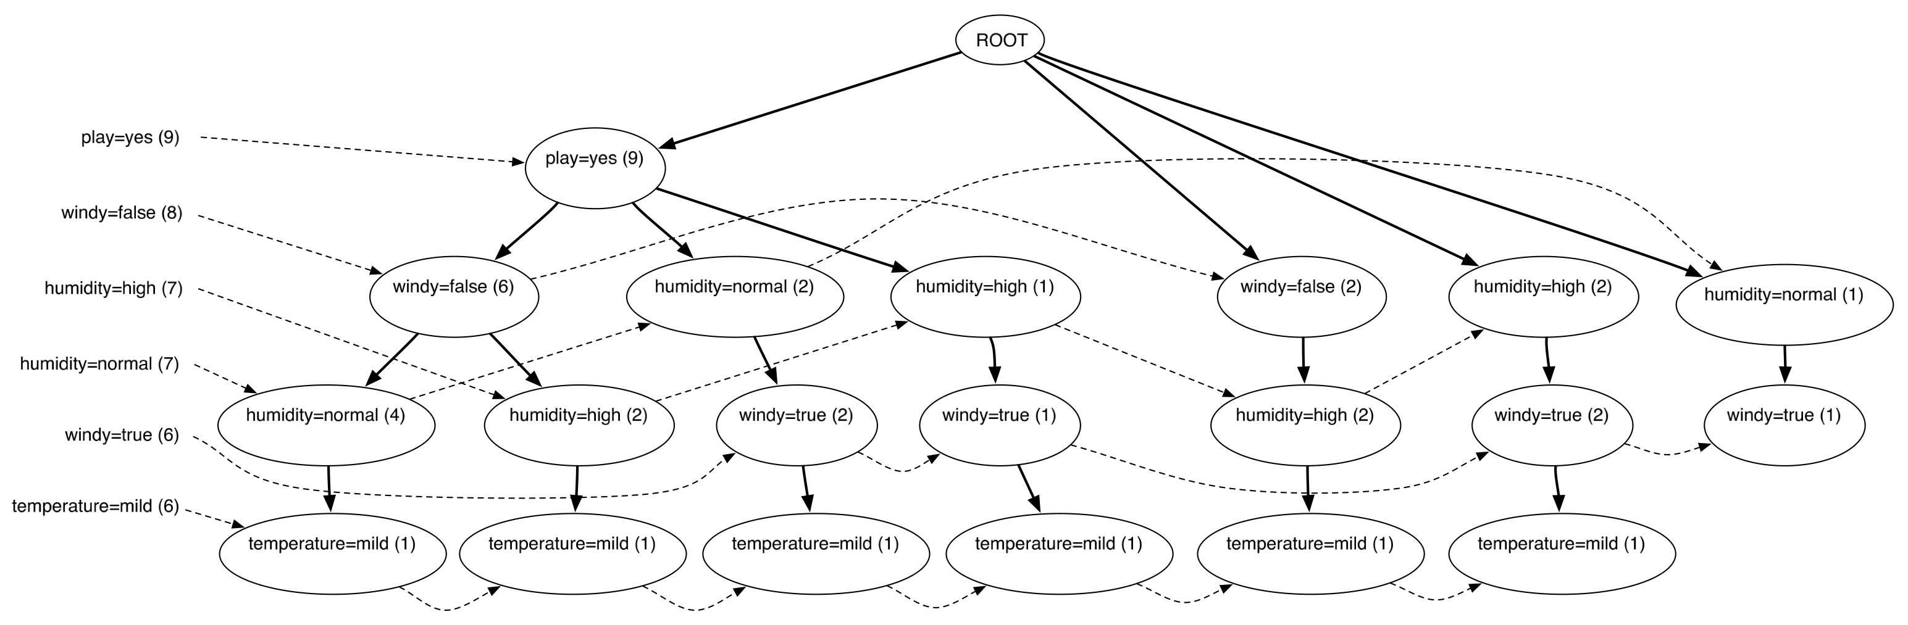
Finding large item sets
FP-tree for the weather data (min support 6)
Process header table from bottom
  Add temperature=mild to the list of large item sets
  Are there any item sets containing temperature=mild that meet min support?

Slide 50
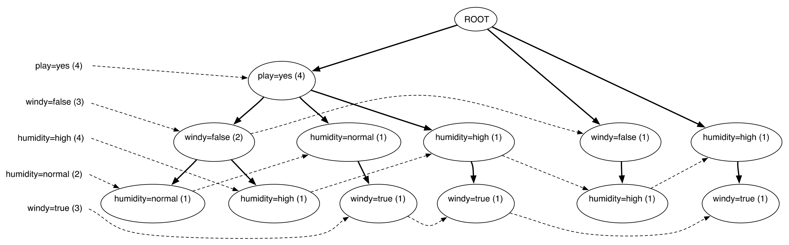
Finding large item sets cont.
FP-tree for the data conditioned on temperature=mild
Created by scanning the first (original) tree
  Follow temperature=mild link from header table to find all instances that contain temperature=mild
  Project counts from original tree
Header table shows that temperature=mild can't be grown any longer

Slide 51
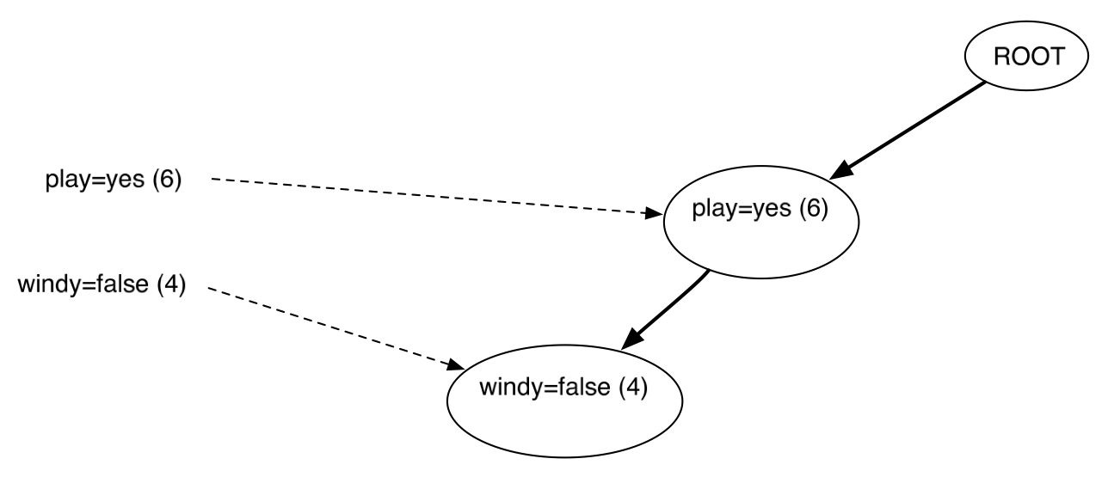
Finding large item sets cont.
FP-tree for the data conditioned on humidity=normal
Created by scanning the first (original) tree
  Follow humidity=normal link from header table to find all instances that contain humidity=normal
  Project counts from original tree
Header table shows that humidty=normal can be grown to include play=yes

Slide 52
Finding large item sets cont.
All large item sets have now been found
However, in order to be sure it is necessary to process the entire header link table from the original tree
Association rules are formed from large item sets in the same way as for Apriori
FP-growth can be up to an order of magnitude faster than Apriori for finding large item sets

Slide 53
Extending linear classification
Linear classifiers can’t model nonlinear class boundaries
Simple trick:
  Map attributes into new space consisting of combinations of attribute values
  E.g.: all products of n factors that can be constructed from the attributes
Example with two attributes and n = 3:

Slide 54
Problems with this approach
1st problem: speed
  10 attributes, and n = 5 ⇒ >2000 coefficients
  Use linear regression with attribute selection
  Run time is cubic in number of attributes
2nd problem: overfitting
  Number of coefficients is large relative to the number of training instances
  Curse of dimensionality kicks in

Slide 55
Support vector machines
Support vector machines are algorithms for learning linear classifiers
Resilient to overfitting because they learn a particular linear decision boundary:
  The maximum margin hyperplane
Fast in the nonlinear case
  Use a mathematical trick to avoid creating “pseudo-attributes”
  The nonlinear space is created implicitly

Slide 56
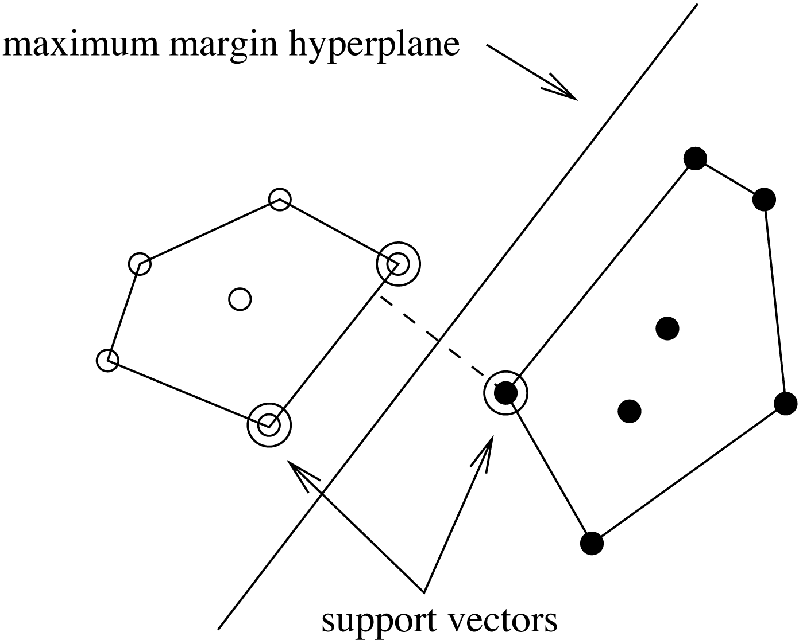
The maximum margin hyperplane
The instances closest to the maximum margin hyperplane are called support vectors

Slide 57
Support vectors
The support vectors define the maximum margin hyperplane
  All other instances can be deleted without changing its position and orientation
This means the hyperplane
can be written as

Slide 58
Finding support vectors
Support vector: training instance for which α_{i} > 0
Determine α_{i} and b ?—
A constrained quadratic optimization problem
  Off-the-shelf tools for solving these problems
  However, special-purpose algorithms are faster
  Example: Platt’s sequential minimal optimization algorithm (implemented in WEKA)
Note: all this assumes separable data!

Slide 59
Nonlinear SVMs
“Pseudo attributes” represent attribute combinations
Overfitting not a problem because the maximum margin hyperplane is stable
  There are usually few support vectors relative to the size of the training set
Computation time still an issue
  Each time the dot product is computed, all the “pseudo attributes” must be included

Slide 60
A mathematical trick
Avoid computing the “pseudo attributes”
Compute the dot product before doing the nonlinear mapping
Example:
Corresponds to a map into the instance space spanned by all products of n attributes

Slide 61
Other kernel functions
Mapping is called a “kernel function”
Polynomial kernel
We can use others:
Only requirement:
Examples:
*

Slide 62
Noise
Have assumed that the data is separable (in original or transformed space)
Can apply SVMs to noisy data by introducing a “noise” parameter C
C bounds the influence of any one training instance on the decision boundary
  Corresponding constraint: 0 ≤ α_{i} ≤ C
Still a quadratic optimization problem
Have to determine C by experimentation

Slide 63
Sparse data
SVM algorithms speed up dramatically if the data is sparse (i.e. many values are 0)
Why? Because they compute lots and lots of dot products
Sparse data ⇒
compute dot products very efficiently
  Iterate only over non-zero values
SVMs can process sparse datasets with 10,000s of attributes

Slide 64
Applications
Machine vision: e.g face identification
  Outperforms alternative approaches (1.5% error)
Handwritten digit recognition: USPS data
  Comparable to best alternative (0.8% error)
Bioinformatics: e.g. prediction of protein secondary structure
Text classifiation
Can modify SVM technique for numeric prediction problems

Slide 65
Support vector regression
Maximum margin hyperplane only applies to classification
However, idea of support vectors and kernel functions can be used for regression
Basic method same as in linear regression: want to minimize error
  Difference A: ignore errors smaller than ε and use absolute error instead of squared error
  Difference B: simultaneously aim to maximize flatness of function
User-specified parameter ε defines “tube”

Slide 66
More on SVM regression
If there are tubes that enclose all the training points, the flattest of them is used
  Eg.: mean is used if 2ε > range of target values
Model can be written as:
  Support vectors: points on or outside tube
  Dot product can be replaced by kernel function
  Note: coefficients αimay be negative
No tube that encloses all training points?
  Requires trade-off between error and flatness
  Controlled by upper limit C on absolute value of coefficients αi

Slide 67
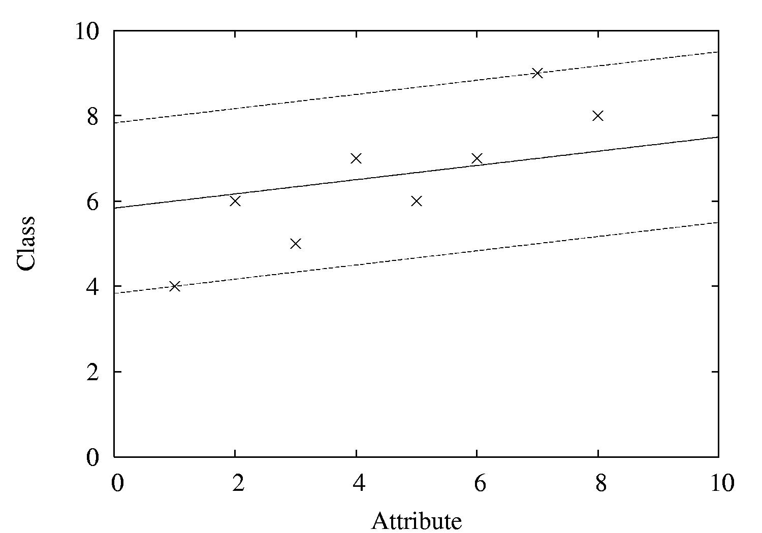
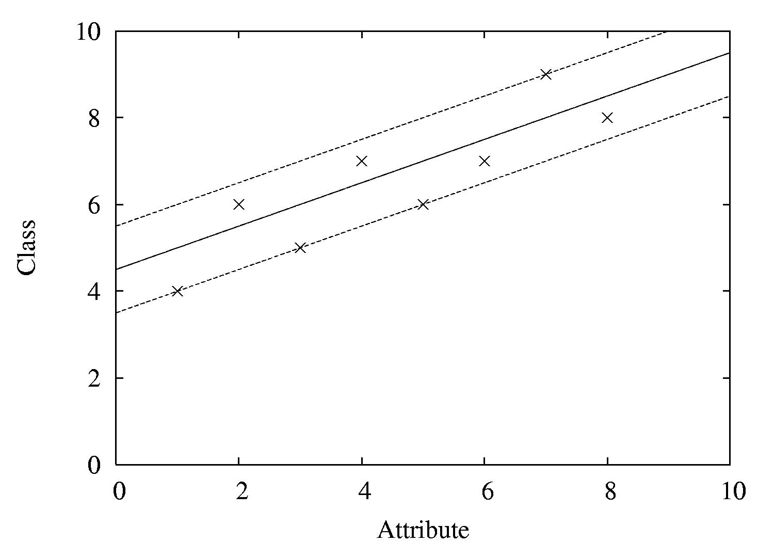
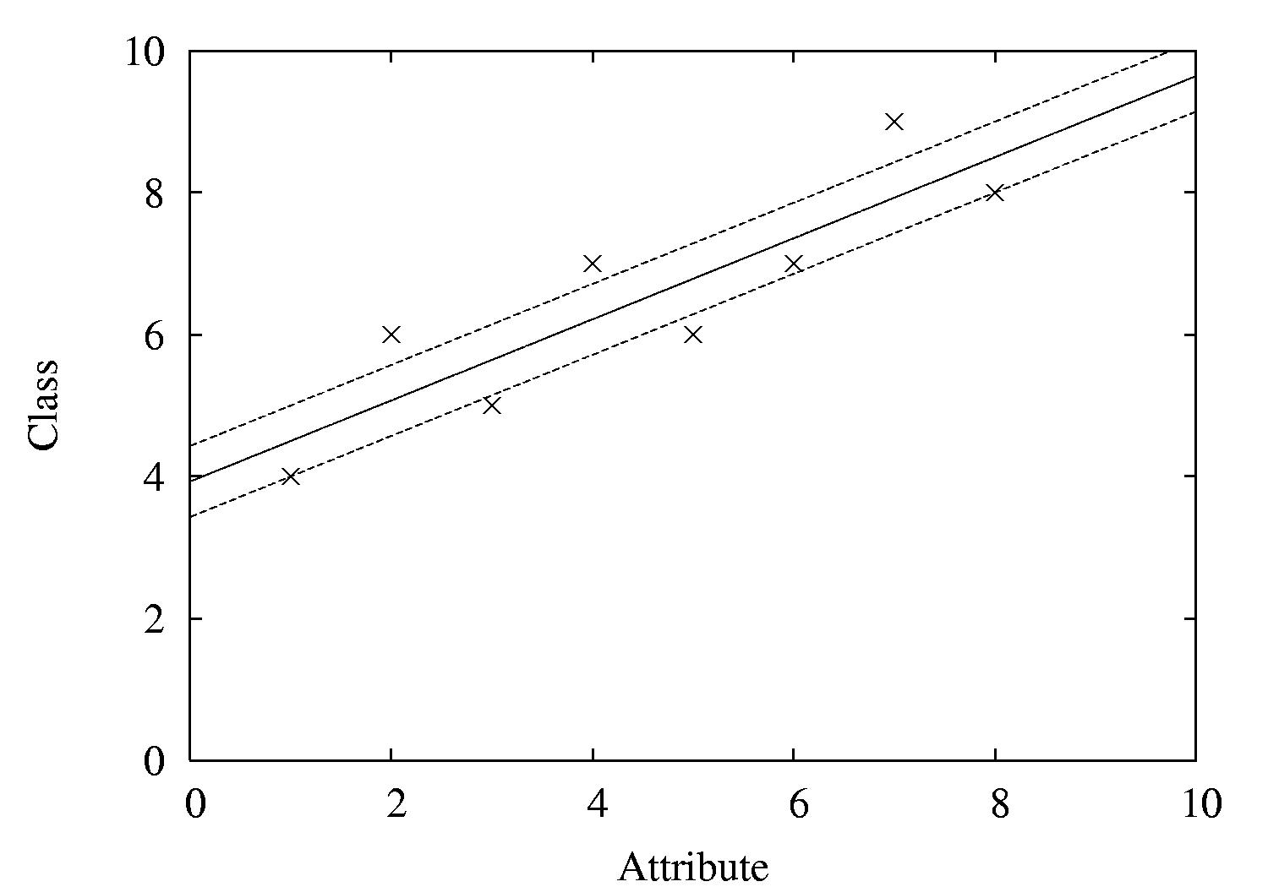
Examples
ε = 2
ε = 1
ε = 0.5

Slide 68
Kernel Ridge Regression
For classic linear regression using squared loss, only simple matrix operations are need to find the model
  Not the case for support vector regression with user-specified loss ε
Combine the power of the kernel trick with simplicity of standard least-squares regression?
  Yes! Kernel ridge regression

Slide 69
Kernel Ridge Regression
Like SVM, predicted class value for a test instance a is expressed as a weighted sum over the dot product of the test instance with training instances
Unlike SVM, all training instances participate – not just support vectors
  No sparseness in solution (no support vectors)
Does not ignore errors smaller than ε
Uses squared error instead of absolute error

Slide 70
Kernel Ridge Regression
More computationally expensive than standard linear regresion when #instances > #attributes
  Standard regression – invert an m × m matrix (O(m³)), m = #attributes
  Kernel ridge regression – invert an n × n matrix (O(n³)), n = #instances
Has an advantage if
  A non-linear fit is desired
  There are more attributes than training instances

Slide 71
The kernel perceptron
Can use “kernel trick” to make non-linear classifier using perceptron rule
Observation: weight vector is modified by adding or subtracting training instances
Can represent weight vector using all instances that have been misclassified:
  Can use
  instead of
  ( where y is either -1 or +1)
Now swap summation signs:
  Can be expressed as:
Can replace dot product by kernel:

Slide 72
Comments on kernel perceptron
Finds separating hyperplane in space created by kernel function (if it exists)
  But: doesn't find maximum-margin hyperplane
Easy to implement, supports incremental learning
Linear and logistic regression can also be upgraded using the kernel trick
  But: solution is not “sparse”: every training instance contributes to solution
Perceptron can be made more stable by using all weight vectors encountered during learning, not just last one (voted perceptron)
  Weight vectors vote on prediction (vote based on number of successful classifications since inception)

Slide 73
Multilayer perceptrons
Using kernels is only one way to build nonlinear classifier based on perceptrons
Can create network of perceptrons to approximate arbitrary target concepts
Multilayer perceptron is an example of an artificial neural network
  Consists of: input layer, hidden layer(s), and output layer
Structure of MLP is usually found by experimentation
Parameters can be found using backpropagation

Slide 74
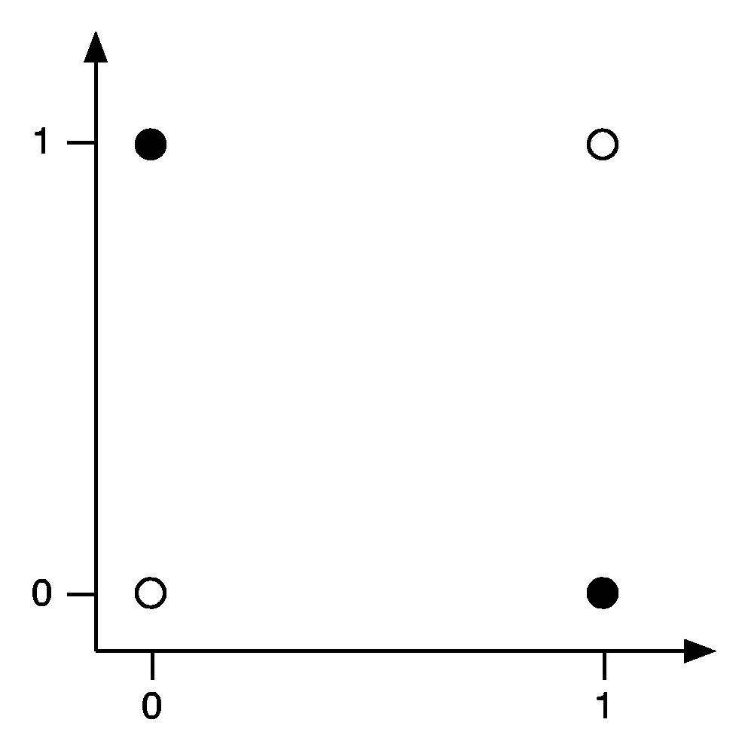
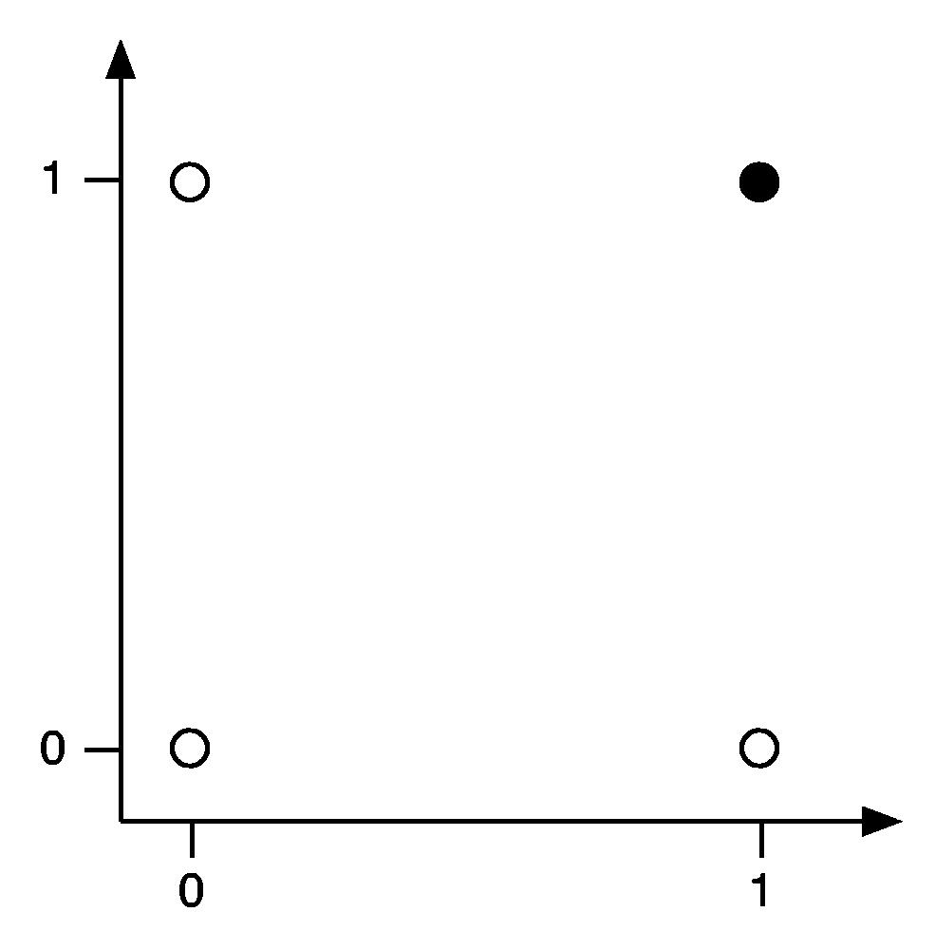
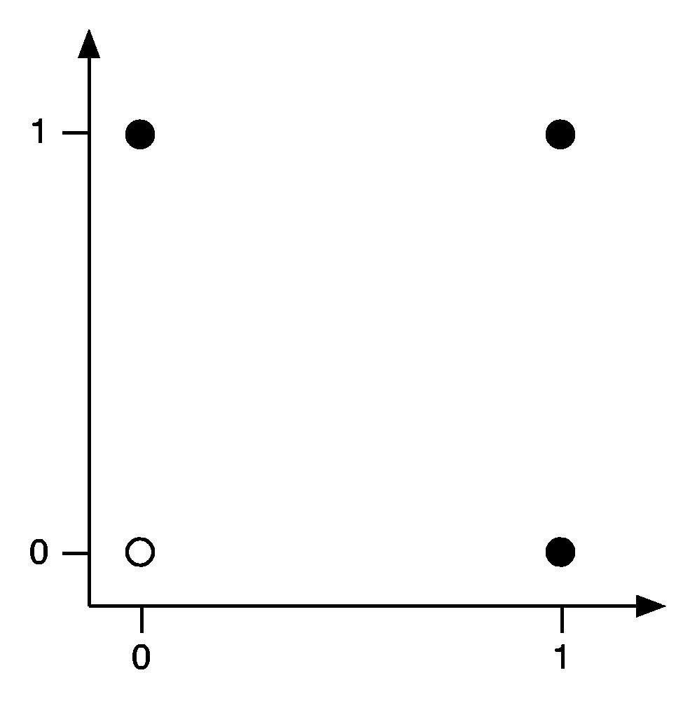
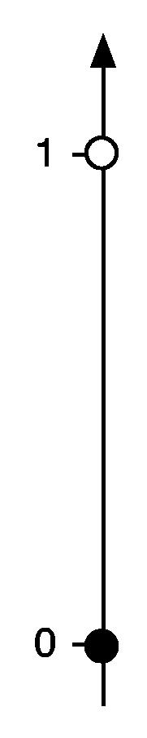
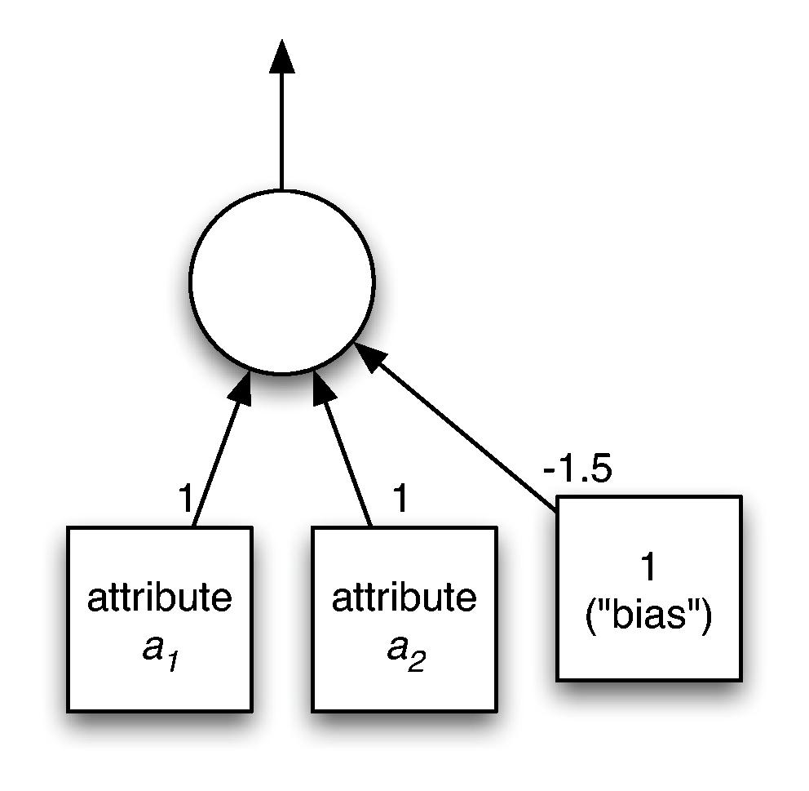
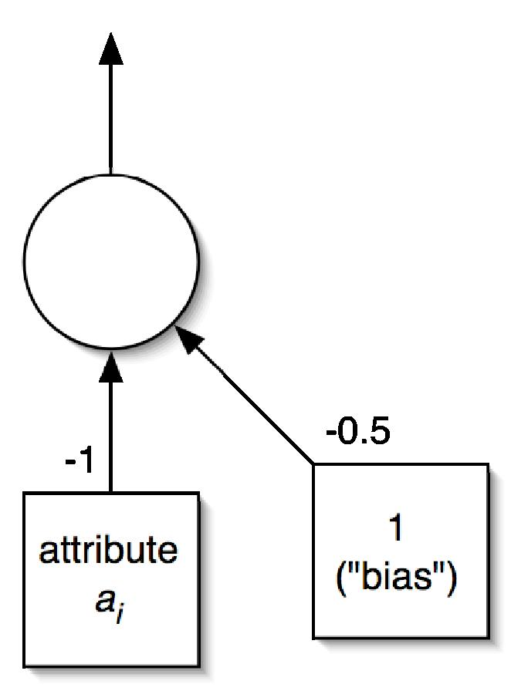
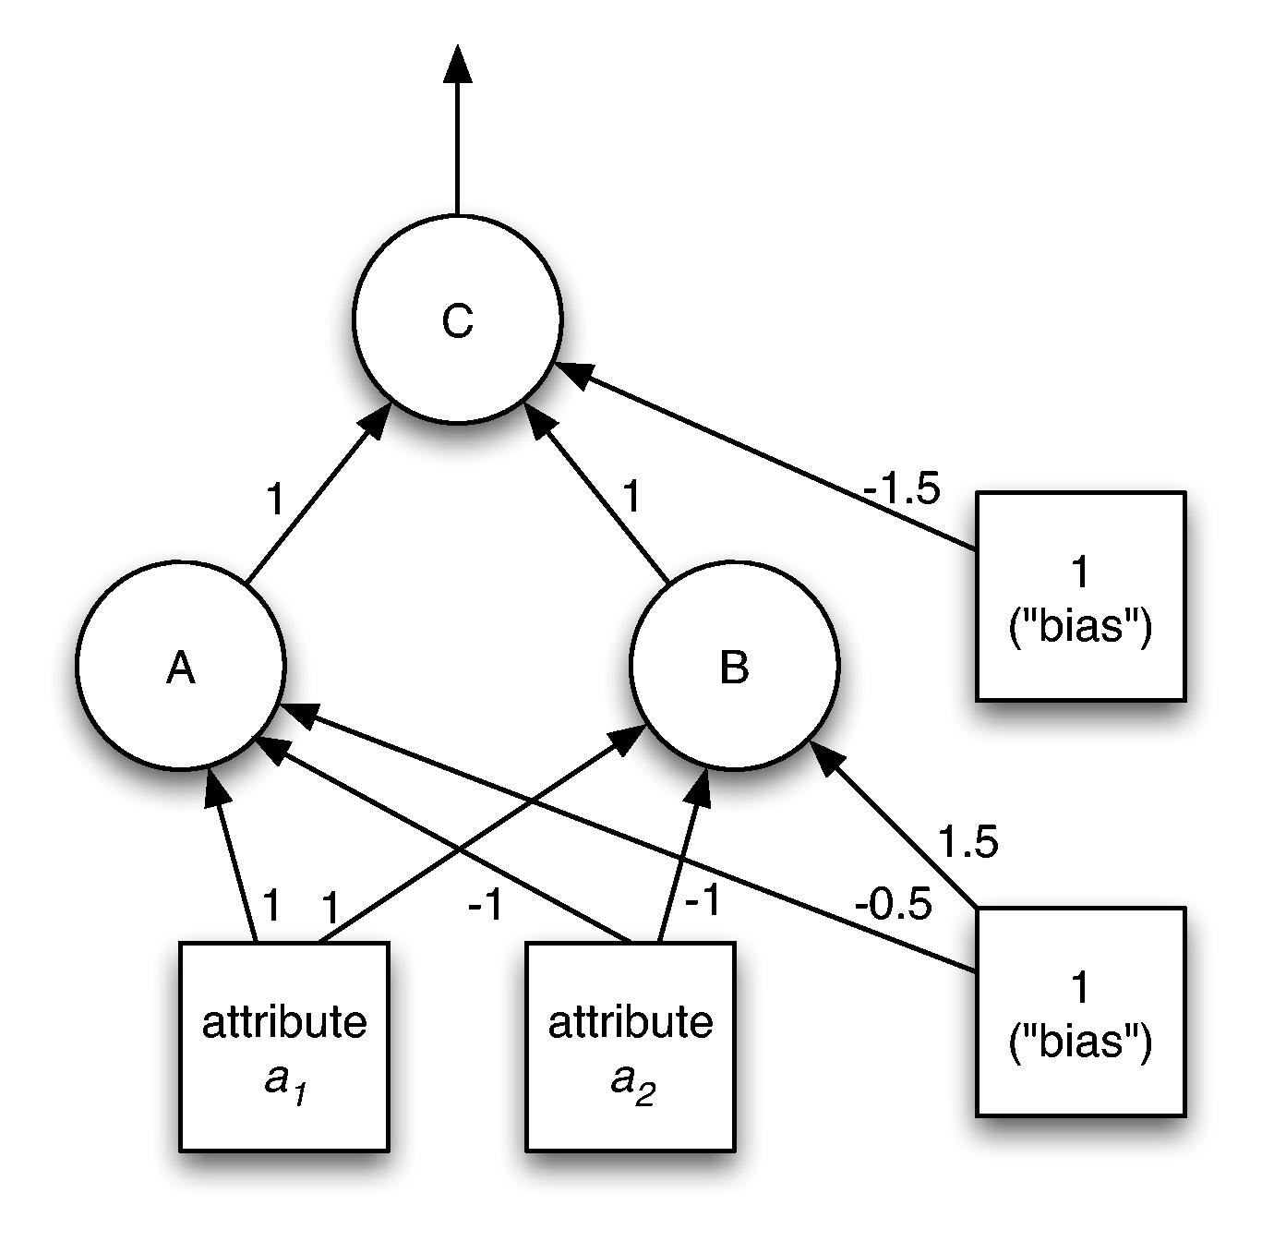

Examples

Slide 75
Backpropagation
How to learn weights given network structure?
  Cannot simply use perceptron learning rule because we have hidden layer(s)
  Function we are trying to minimize: error
  Can use a general function minimization technique called gradient descent
    Need differentiable activation function: use sigmoid function instead of threshold function
    Need differentiable error function: can't use zero-one loss, but can use squared error

Slide 76
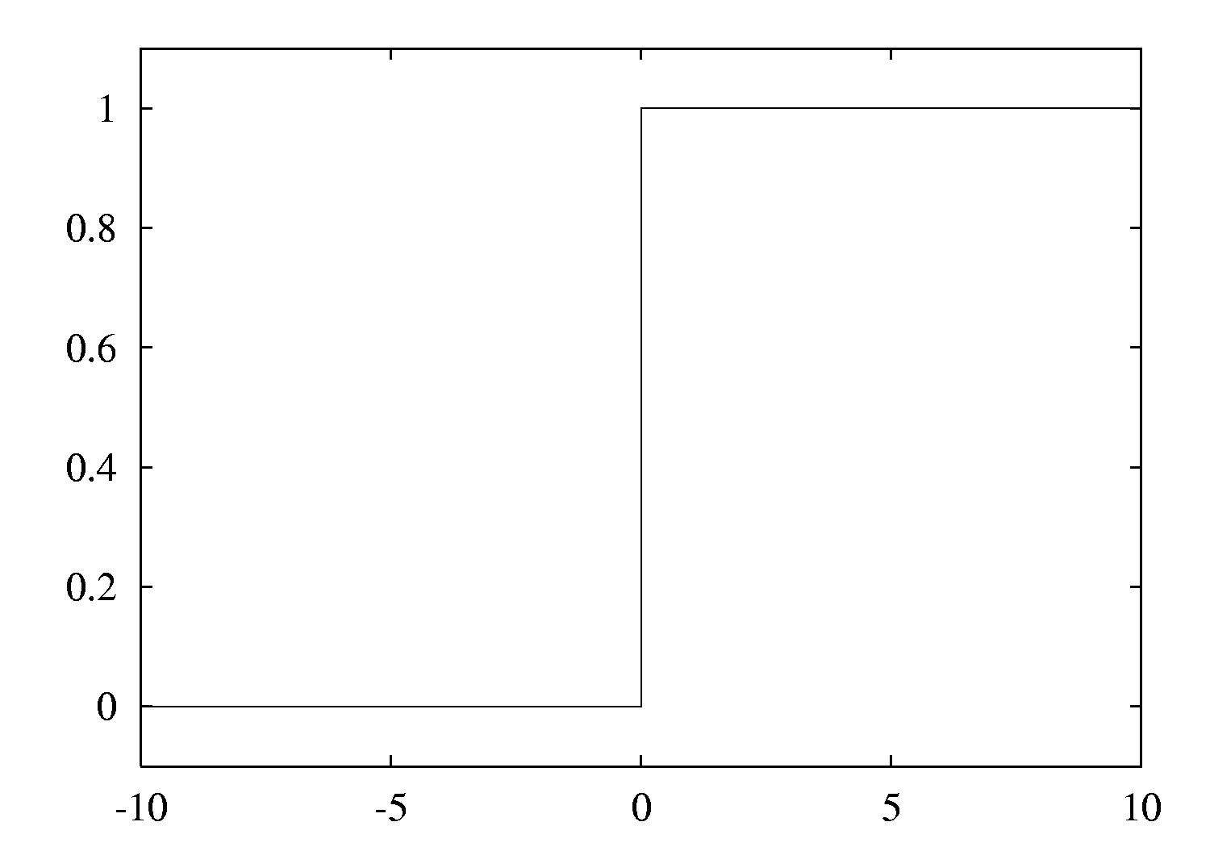
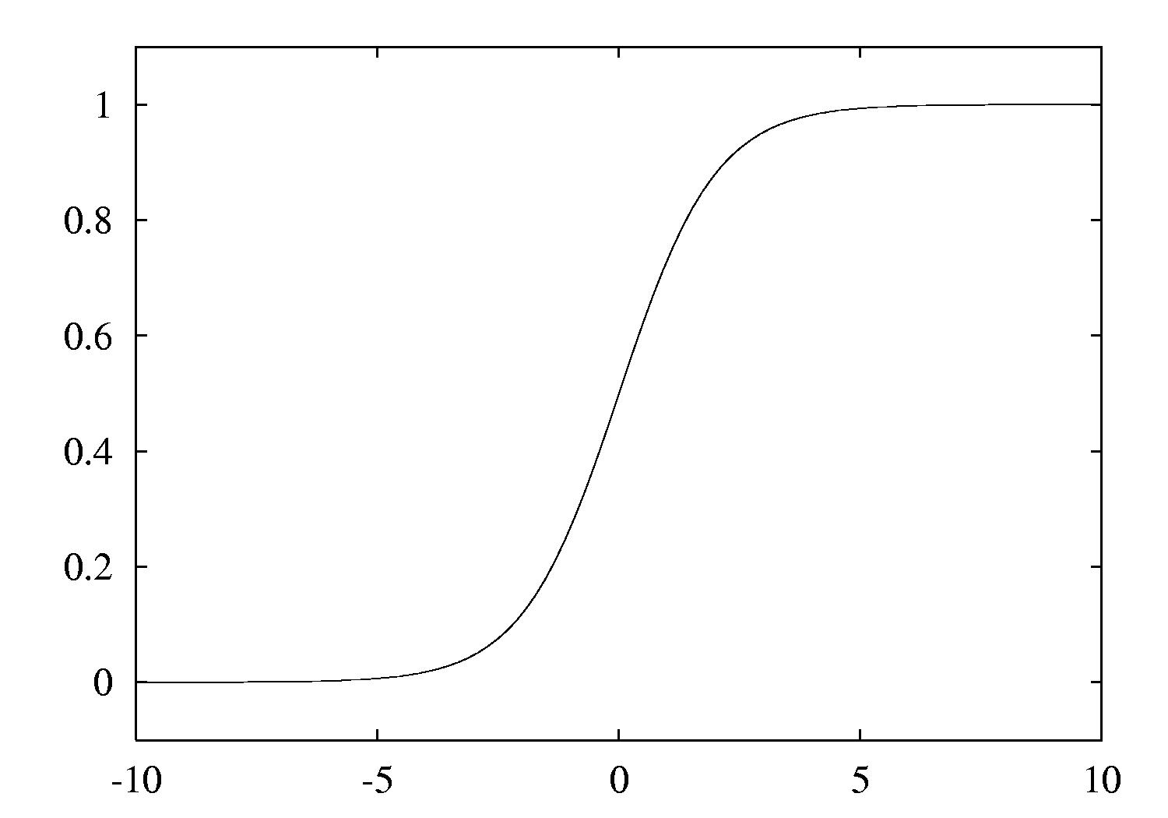
The two activation functions

Slide 77
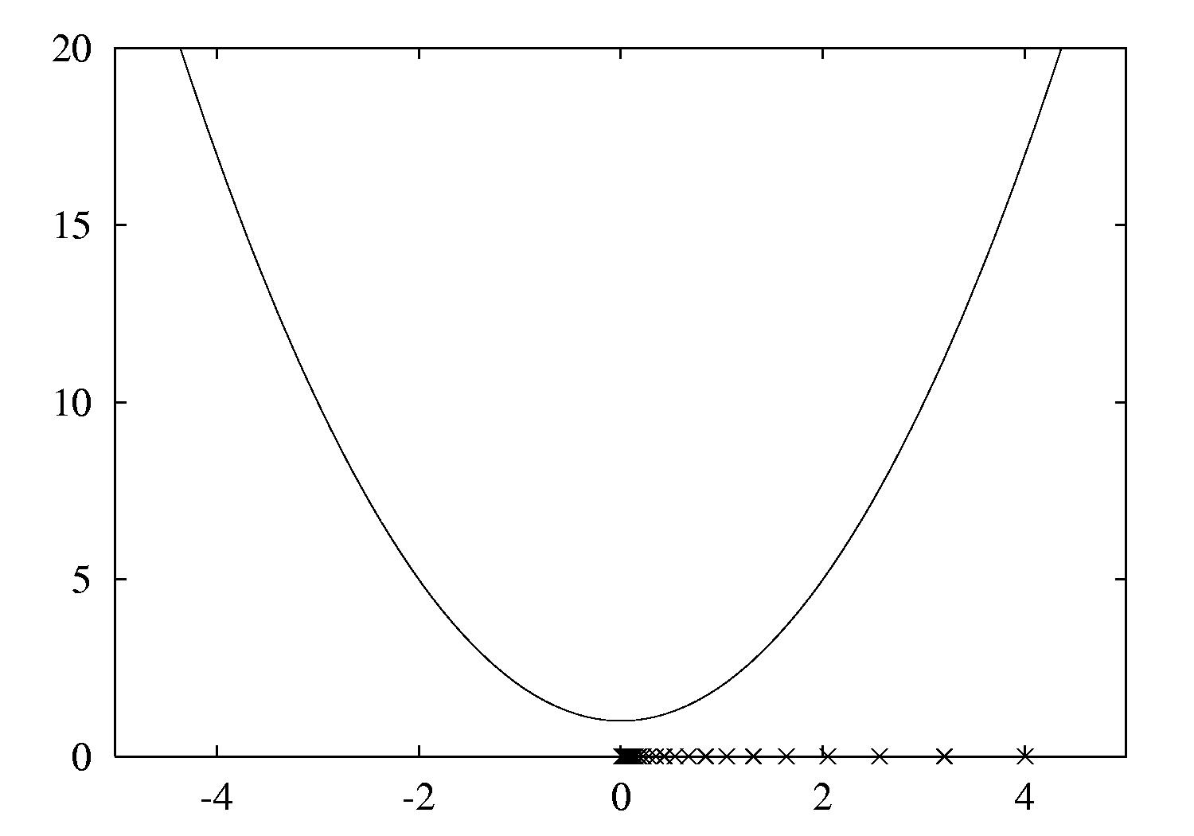
Gradient descent example
Function: x²+1
Derivative: 2x
Learning rate: 0.1
Start value: 4
Can only find a local minimum!

Slide 78
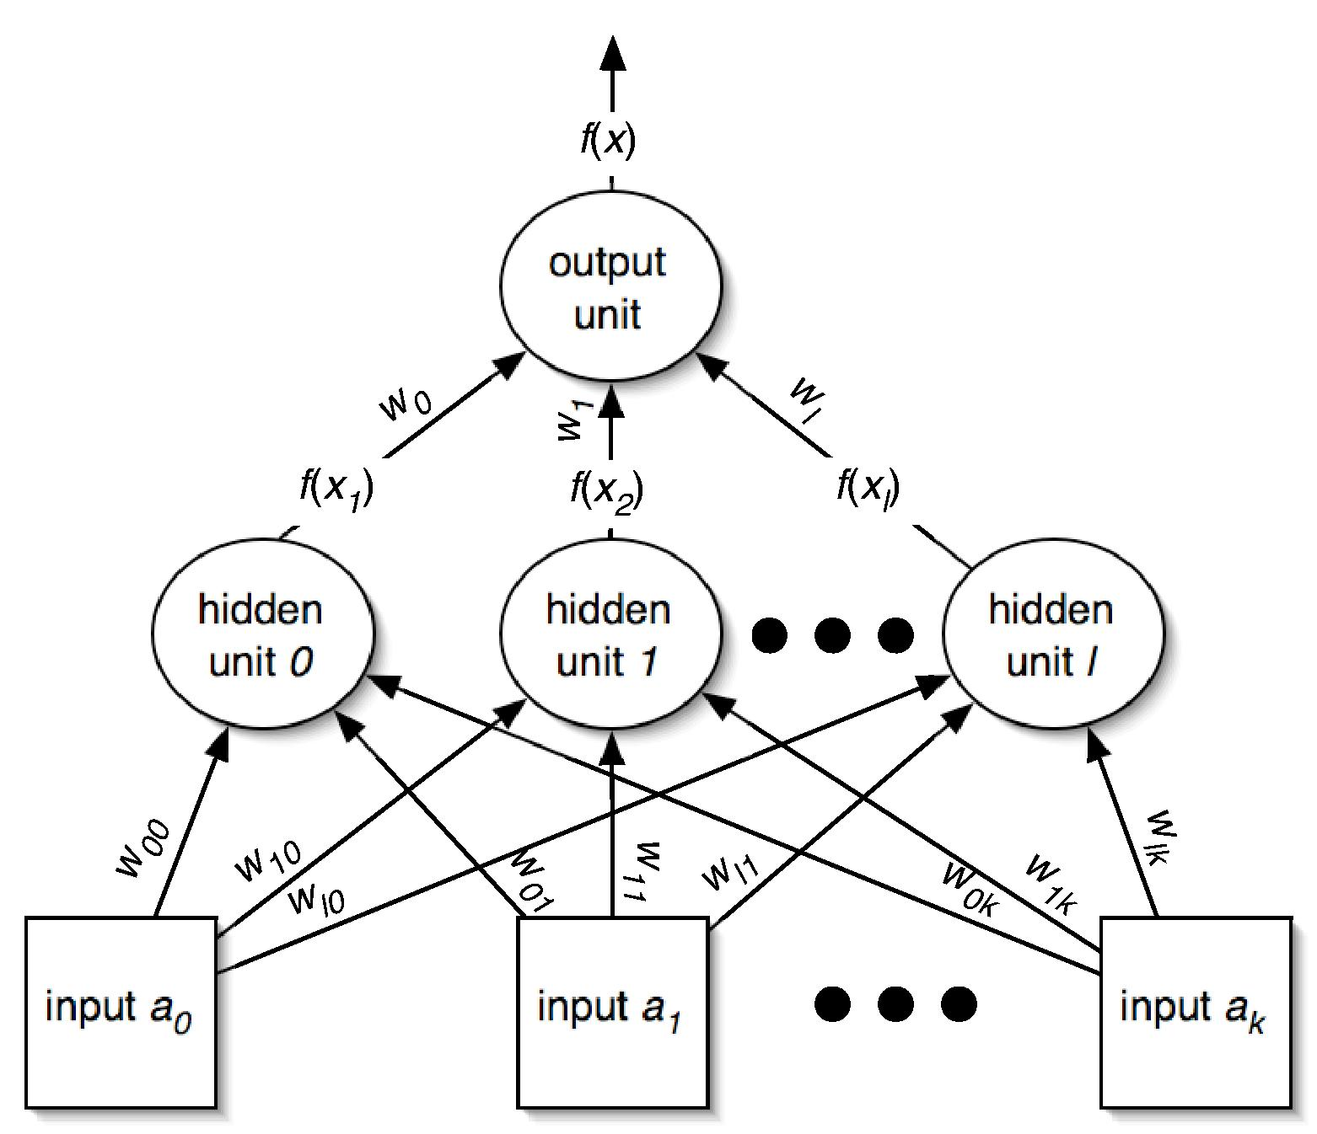
Minimizing the error I
Need to find partial derivative of error function for each parameter (i.e. weight)

Slide 79
Minimizing the error II
What about the weights for the connections from the input to the hidden layer?

Slide 80
Remarks
Same process works for multiple hidden layers and multiple output units (eg. for multiple classes)
Can update weights after all training instances have been processed or incrementally:
  batch learning vs. stochastic backpropagation
  Weights are initialized to small random values
How to avoid overfitting?
  Early stopping: use validation set to check when to stop
  Weight decay: add penalty term to error function
How to speed up learning?
  Momentum: re-use proportion of old weight change
  Use optimization method that employs 2nd derivative

Slide 81
Radial basis function networks
Another type of feedforward network with two layers (plus the input layer)
Hidden units represent points in instance space and activation depends on distance
  To this end, distance is converted into similarity: Gaussian activation function
    Width may be different for each hidden unit
  Points of equal activation form hypersphere (or hyperellipsoid) as opposed to hyperplane
Output layer same as in MLP

Slide 82
Learning RBF networks
Parameters: centers and widths of the RBFs + weights in output layer
Can learn two sets of parameters independently and still get accurate models
  Eg.: clusters from k-means can be used to form basis functions
  Linear model can be used based on fixed RBFs
  Makes learning RBFs very efficient
Disadvantage: no built-in attribute weighting based on relevance
RBF networks are related to RBF SVMs

Slide 83
Stochastic gradient descent
Have seen gradient descent + stochastic backpropagation for learning weights in a neural network
Gradient descent is a general-purpose optimization technique
  Can be applied whenever the objective function is differentiable
  Actually, can be used even when the objective function is not completely differentiable!
    Subgradients
One application: learn linear models – e.g. linear SVMs or logistic regression

Slide 84
Stochastic gradient descent cont.
Learning linear models using gradient descent is easier than optimizing non-linear NN
  Objective function has global minimum rather than many local minima
Stochastic gradient descent is fast, uses little memory and is suitable for incremental online learning

Slide 85
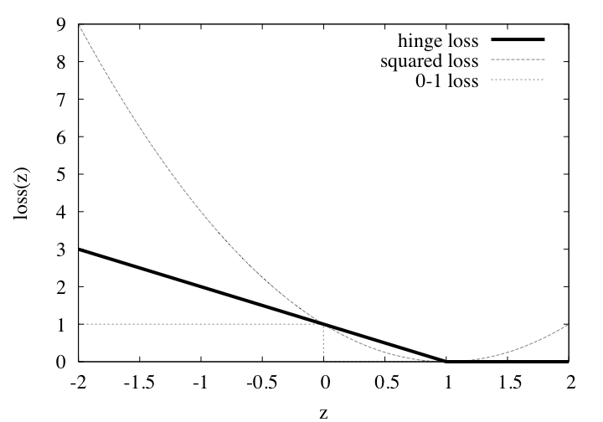
Stochastic gradient descent cont.
For SVMs, the error function (to be minimized) is called the hinge loss

Slide 86
Stochastic gradient descent cont.
In the linearly separable case, the hinge loss is 0 for a function that successfully separates the data
  The maximum margin hyperplane is given by the smallest weight vector that achieves 0 hinge loss
Hinge loss is not differentiable at z = 1; cant compute gradient!
  Subgradient – something that resembles a gradient
  Use 0 at z = 1
  In fact, loss is 0 for z ≥ 1, so can focus on z < 1 and proceed as usual

Slide 87
Instance-based learning
Practical problems of 1-NN scheme:
  Slow (but: fast tree-based approaches exist)
    Remedy: remove irrelevant data
  Noise (but: k -NN copes quite well with noise)
    Remedy: remove noisy instances
  All attributes deemed equally important
    Remedy: weight attributes (or simply select)
  Doesn’t perform explicit generalization
    Remedy: rule-based NN approach

Slide 88
Learning prototypes
Only those instances involved in a decision need to be stored
Noisy instances should be filtered out
Idea: only use prototypical examples

Slide 89
Speed up, combat noise
IB2: save memory, speed up classification
  Work incrementally
  Only incorporate misclassified instances
  Problem: noisy data gets incorporated
IB3: deal with noise
  Discard instances that don’t perform well
  Compute confidence intervals for
    1. Each instance’s success rate
    2. Default accuracy of its class
  Accept/reject instances
    Accept if lower limit of 1 exceeds upper limit of 2
    Reject if upper limit of 1 is below lower limit of 2

Slide 90
Weight attributes
IB4: weight each attribute
(weights can be class-specific)
Weighted Euclidean distance:
Update weights based on nearest neighbor
  Class correct: increase weight
  Class incorrect: decrease weight
  Amount of change for i th attribute depends on
  |x_{i}- y_{i}|

Slide 91
Rectangular generalizations
Nearest-neighbor rule is used outside rectangles
Rectangles are rules! (But they can be more conservative than “normal” rules.)
Nested rectangles are rules with exceptions

Slide 92
Generalized exemplars
Generalize instances into hyperrectangles
  Online: incrementally modify rectangles
  Offline version: seek small set of rectangles that cover the instances
Important design decisions:
  Allow overlapping rectangles?
    Requires conflict resolution
  Allow nested rectangles?
  Dealing with uncovered instances?

Slide 93
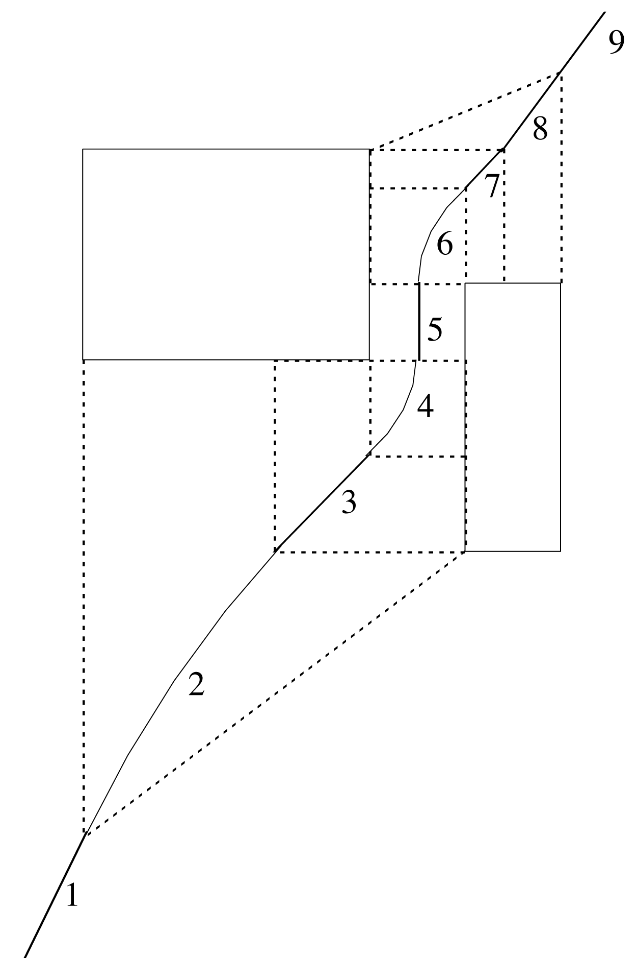
Separating generalized exemplars
Class 1
Class
2
Separation line

Slide 94
Generalized distance functions
Given: some transformation operations on attributes
K*: similarity = probability of transforming instance A into B by chance
  Average over all transformation paths
  Weight paths according their probability
  (need way of measuring this)
Uniform way of dealing with different attribute types
Easily generalized to give distance between sets of instances

Slide 95
Numeric prediction
Counterparts exist for all schemes previously discussed
  Decision trees, rule learners, SVMs, etc.
(Almost) all classification schemes can be applied to regression problems using discretization
  Discretize the class into intervals
  Predict weighted average of interval midpoints
  Weight according to class probabilities

Slide 96
Regression trees
Like decision trees, but:
  Splitting criterion: minimize intra-subset variation
  Termination criterion: std dev becomes small
  Pruning criterion: based on numeric error measure
  Prediction: Leaf predicts average class values of instances
Piecewise constant functions
Easy to interpret
More sophisticated version: model trees

Slide 97
Model trees
Build a regression tree
Each leaf ⇒ linear regression function
Smoothing: factor in ancestor’s predictions
  Smoothing formula:
  Same effect can be achieved by incorporating ancestor models into the leaves
Need linear regression function at each node
At each node, use only a subset of attributes
  Those occurring in subtree
  (+maybe those occurring in path to the root)
Fast: tree usually uses only a small subset of the attributes

Slide 98
Building the tree
Splitting: standard deviation reduction
Termination:
  Standard deviation < 5% of its value on full training set
  Too few instances remain (e.g. < 4)
Pruning:
  Heuristic estimate of absolute error of LR models:
  Greedily remove terms from LR models to minimize estimated error
  Heavy pruning: single model may replace whole subtree
  Proceed bottom up: compare error of LR model at internal node to error of subtree

Slide 99
Nominal attributes
Convert nominal attributes to binary ones
  Sort attribute by average class value
  If attribute has k values,
  generate k – 1 binary attributes
    i th is 0 if value lies within the first i , otherwise 1
Treat binary attributes as numeric
Can prove: best split on one of the new attributes is the best (binary) split on original

Slide 100
Missing values
Modify splitting criterion:
To determine which subset an instance goes into, use surrogate splitting
  Split on the attribute whose correlation with original is greatest
  Problem: complex and time-consuming
  Simple solution: always use the class
Test set: replace missing value with average

Slide 101
Surrogate splitting based on class
Choose split point based on instances with known values
Split point divides instances into 2 subsets
  L (smaller class average)
  R (larger)
m is the average of the two averages
For an instance with a missing value:
  Choose L if class value < m
  Otherwise R
Once full tree is built, replace missing values with averages of corresponding leaf nodes

Slide 102
Pseudo-code for M5'
Four methods:
  Main method: MakeModelTree
  Method for splitting: split
  Method for pruning: prune
  Method that computes error: subtreeError
We’ll briefly look at each method in turn
Assume that linear regression method performs attribute subset selection based on error

Slide 103
MakeModelTree
MakeModelTree (instances)
{
SD = sd(instances)
for each k-valued nominal attribute
convert into k-1 synthetic binary attributes
root = newNode
root.instances = instances
split(root)
prune(root)
printTree(root)
}

Slide 104
split
split(node)
{
if sizeof(node.instances) < 4 or
sd(node.instances) < 0.05*SD
node.type = LEAF
else
node.type = INTERIOR
for each attribute
for all possible split positions of attribute
calculate the attribute's SDR
node.attribute = attribute with maximum SDR
split(node.left)
split(node.right)
}

Slide 105
prune
prune(node)
{
if node = INTERIOR then
prune(node.leftChild)
prune(node.rightChild)
node.model = linearRegression(node)
if subtreeError(node) > error(node) then
node.type = LEAF
}

Slide 106
subtreeError
subtreeError(node)
{
l = node.left; r = node.right
if node = INTERIOR then
return (sizeof(l.instances)*subtreeError(l)
+ sizeof(r.instances)*subtreeError(r))
/sizeof(node.instances)
else return error(node)
}

Slide 107
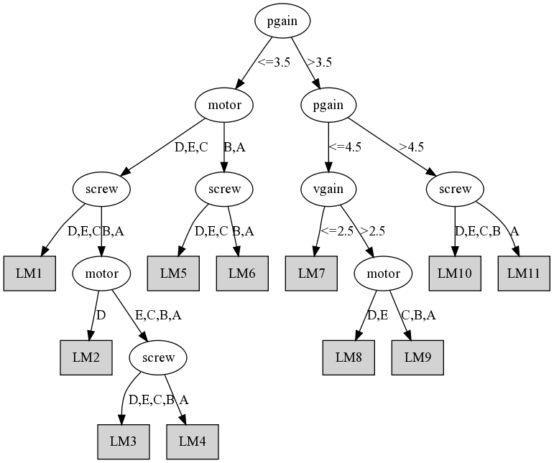
Model tree for servo data

Slide 108
Rules from model trees
PART algorithm generates classification rules by building partial decision trees
Can use the same method to build rule sets for regression
  Use model trees instead of decision trees
  Use variance instead of entropy to choose node to expand when building partial tree
Rules will have linear models on right-hand side
Caveat: using smoothed trees may not be appropriate due to separate-and-conquer strategy

Slide 109
Locally weighted regression
Numeric prediction that combines
  instance-based learning
  linear regression
“Lazy”:
  computes regression function at prediction time
  works incrementally
Weight training instances
  according to distance to test instance
  needs weighted version of linear regression
Advantage: nonlinear approximation
But: slow

Slide 110
Design decisions
Weighting function:
  Inverse Euclidean distance
  Gaussian kernel applied to Euclidean distance
  Triangular kernel used the same way
  etc.
Smoothing parameter is used to scale the distance function
  Multiply distance by inverse of this parameter
  Possible choice: distance of k th nearest training instance (makes it data dependent)

Slide 111
Discussion
Regression trees were introduced in CART
Quinlan proposed model tree method (M5)
M5’: slightly improved, publicly available
Quinlan also investigated combining instance-based learning with M5
CUBIST: Quinlan’s commercial rule learner for numeric prediction
Interesting comparison: neural nets vs. M5

Slide 112
From naïve Bayes to Bayesian Networks
Naïve Bayes assumes:
attributes conditionally independent given the class
Doesn’t hold in practice but classification accuracy often high
However: sometimes performance much worse than e.g. decision tree
Can we eliminate the assumption?

Slide 113
Enter Bayesian networks
Graphical models that can represent any probability distribution
Graphical representation: directed acyclic graph, one node for each attribute
Overall probability distribution factorized into component distributions
Graph’s nodes hold component distributions (conditional distributions)

Slide 114
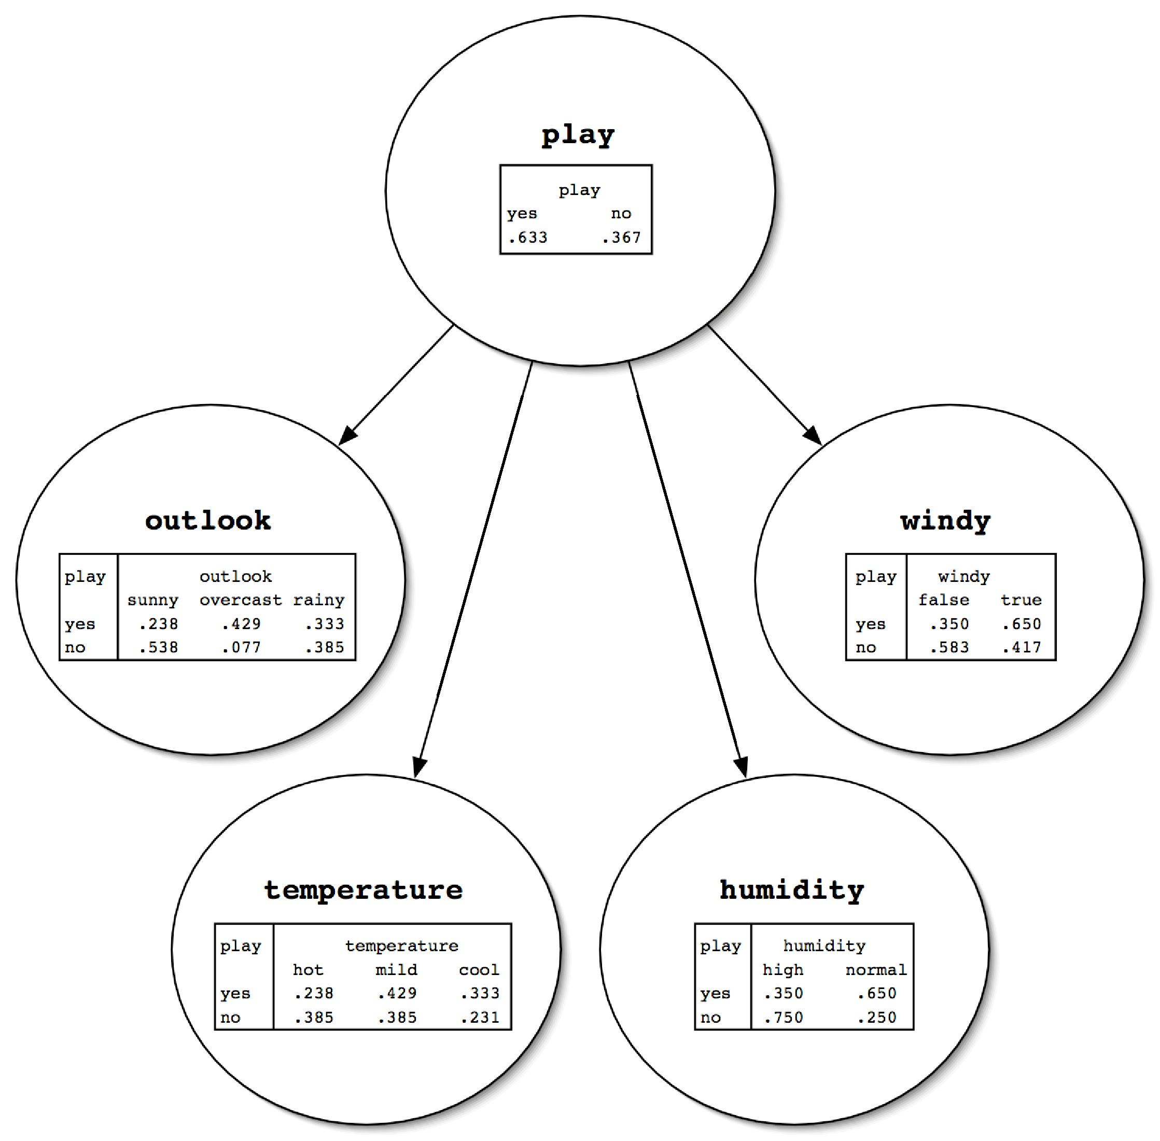
Network for the weather data

Slide 115
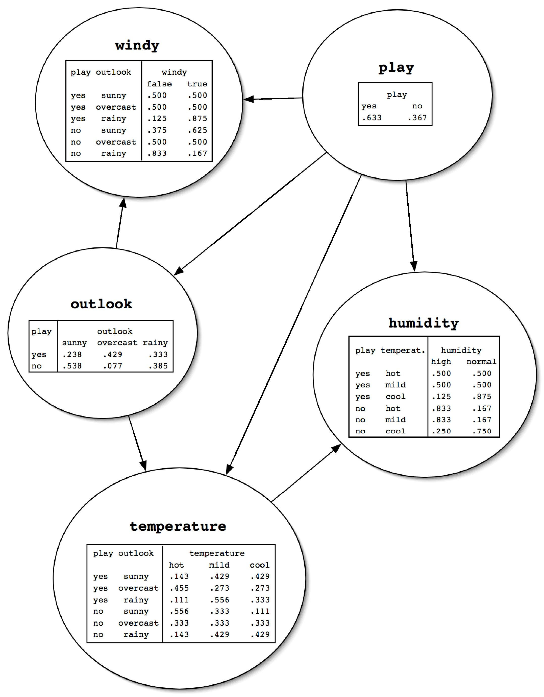
Network for the weather data

Slide 116
Computing the class probabilities
Two steps: computing a product of probabilities for each class and normalization
  For each class value
    Take all attribute values and class value
    Look up corresponding entries in conditional probability distribution tables
    Take the product of all probabilities
  Divide the product for each class by the sum of the products (normalization)

Slide 117
Why can we do this? (Part I)
Single assumption: values of a node’s parents completely determine probability distribution for current node
Means that node/attribute is conditionally independent of other ancestors given parents

Slide 118
Why can we do this? (Part II)
Chain rule from probability theory:
Because of our assumption from the previous slide:

Slide 119
Learning Bayes nets
Basic components of algorithms for learning Bayes nets:
  Method for evaluating the goodness of a given network
    Measure based on probability of training data given the network (or the logarithm thereof)
  Method for searching through space of possible networks
    Amounts to searching through sets of edges because nodes are fixed

Slide 120
Problem: overfitting
Can’t just maximize probability of the training data
  Because then it’s always better to add more edges (fit the training data more closely)
Need to use cross-validation or some penalty for complexity of the network
  AIC measure:
  MDL measure:
  LL: log-likelihood (log of probability of data), K: number of free parameters, N: #instances
Another possibility: Bayesian approach with prior distribution over networks

Slide 121
Searching for a good structure
Task can be simplified: can optimize each node separately
  Because probability of an instance is product of individual nodes’ probabilities
  Also works for AIC and MDL criterion because penalties just add up
Can optimize node by adding or removing edges from other nodes
Must not introduce cycles!

Slide 122
The K2 algorithm
Starts with given ordering of nodes (attributes)
Processes each node in turn
Greedily tries adding edges from previous nodes to current node
Moves to next node when current node can’t be optimized further
Result depends on initial order

Slide 123
Some tricks
Sometimes it helps to start the search with a naïve Bayes network
It can also help to ensure that every node is in Markov blanket of class node
  Markov blanket of a node includes all parents, children, and children’s parents of that node
  Given values for Markov blanket, node is conditionally independent of nodes outside blanket
  I.e. node is irrelevant to classification if not in Markov blanket of class node

Slide 124
Other algorithms
Extending K2 to consider greedily adding or deleting edges between any pair of nodes
  Further step: considering inverting the direction of edges
TAN (Tree Augmented Naïve Bayes):
  Starts with naïve Bayes
  Considers adding second parent to each node (apart from class node)
  Efficient algorithm exists

Slide 125
Likelihood vs. conditional likelihood
In classification what we really want is to maximize probability of class given other attributes
  Not probability of the instances
But: no closed-form solution for probabilities in nodes’ tables that maximize this
However: can easily compute conditional probability of data based on given network
Seems to work well when used for network scoring

Slide 126
Data structures for fast learning
Learning Bayes nets involves a lot of counting for computing conditional probabilities
Naïve strategy for storing counts: hash table
  Runs into memory problems very quickly
More sophisticated strategy: all-dimensions (AD) tree
  Analogous to kD-tree for numeric data
  Stores counts in a tree but in a clever way such that redundancy is eliminated
  Only makes sense to use it for large datasets

Slide 127
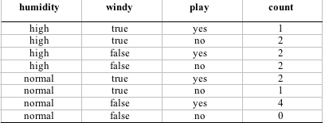
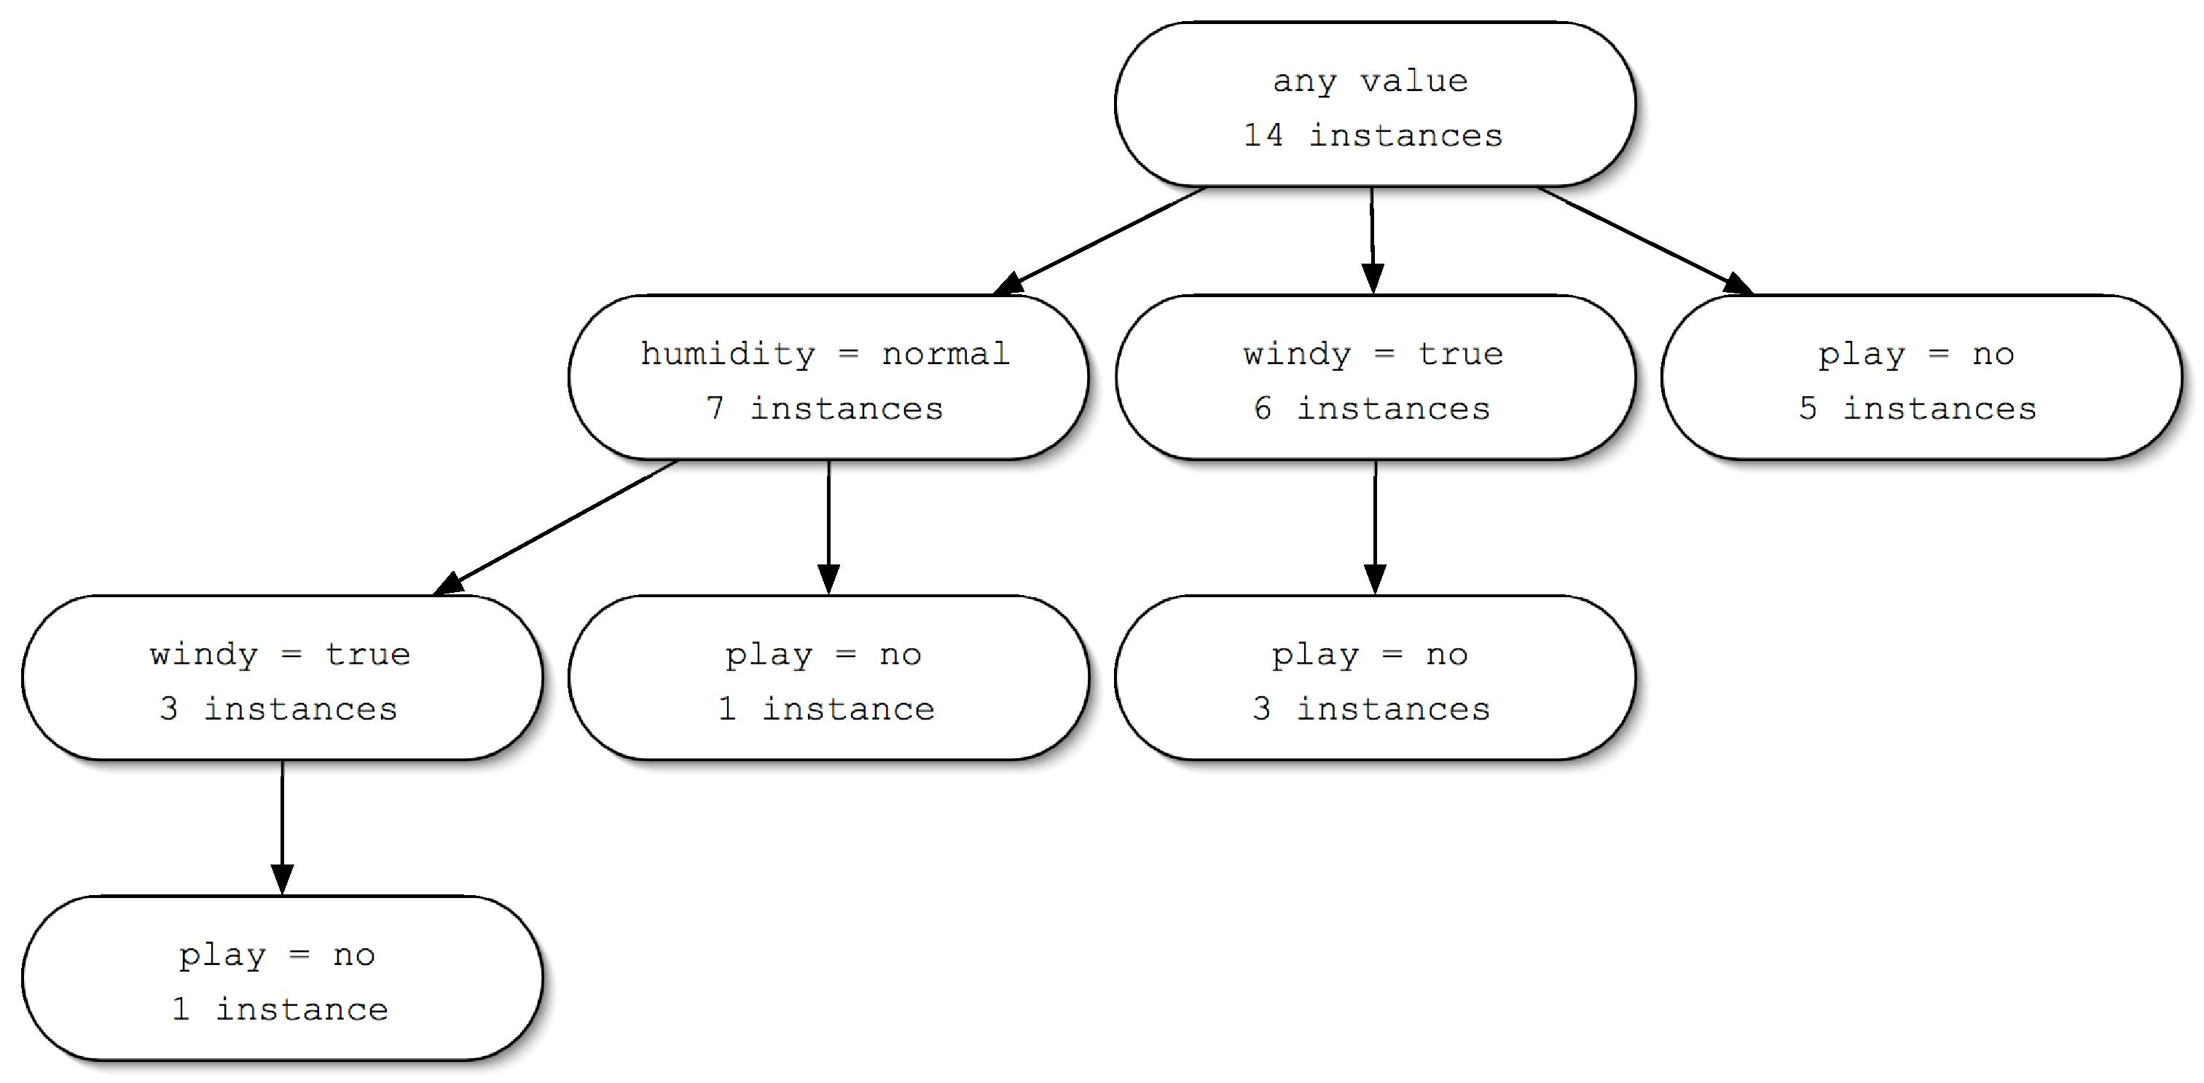
AD tree example

Slide 128
Building an AD tree
Assume each attribute in the data has been assigned an index
Then, expand node for attribute i with the values of all attributes j > i
  Two important restrictions:
    Most populous expansion for each attribute is omitted (breaking ties arbitrarily)
    Expansions with counts that are zero are also omitted
The root node is given index zero

Slide 129
Discussion
We have assumed: discrete data, no missing values, no new nodes
Different method of using Bayes nets for classification: Bayesian multinets
  I.e. build one network for each class and make prediction using Bayes’ rule
Different class of learning methods for Bayes nets: testing conditional independence assertions
Can also build Bayes nets for regression tasks

Slide 130
Clustering: how many clusters?
How to choose k in k-means? Possibilities:
  Choose k that minimizes cross-validated squared distance to cluster centers
  Use penalized squared distance on the training data (eg. using an MDL criterion)
  Apply k-means recursively with k = 2 and use stopping criterion (eg. based on MDL)
    Seeds for subclusters can be chosen by seeding along direction of greatest variance in cluster
    (one standard deviation away in each direction from cluster center of parent cluster)
    Implemented in algorithm called X-means (using Bayesian Information Criterion instead of MDL)

Slide 131
Hierarchical clustering
Recursively splitting clusters produces a hierarchy that can be represented as a dendogram
  Could also be represented as a Venn diagram of sets and subsets (without intersections)
  Height of each node in the dendogram can be made proportional to the dissimilarity between its children

Slide 132
Agglomerative clustering
Bottom-up approach
Simple algorithm
  Requires a distance/similarity measure
  Start by considering each instance to be a cluster
  Find the two closest clusters and merge them
  Continue merging until only one cluster is left
  The record of mergings forms a hierarchical clustering structure – a binary dendogram

Slide 133
Distance measures
Single-linkage
  Minimum distance between the two clusters
  Distance between the clusters closest two members
  Can be sensitive to outliers
Complete-linkage
  Maximum distance between the two clusters
  Two clusters are considered close only if all instances in their union are relatively similar
  Also sensitive to outliers
  Seeks compact clusters

Slide 134
Distance measures cont.
Compromise between the extremes of minimum and maximum distance
Represent clusters by their centroid, and use distance between centroids – centroid linkage
  Works well for instances in multidimensional Euclidean space
  Not so good if all we have is pairwise similarity between instances
Calculate average distance between each pair of members of the two clusters – average-linkage
Technical deficiency of both: results depend on the numerical scale on which distances are measured

Slide 135
More distance measures
Group-average clustering
  Uses the average distance between all members of the merged cluster
  Differs from average-linkage because it includes pairs from the same original cluster
Ward's clustering method
  Calculates the increase in the sum of squares of the distances of the instances from the centroid before and after fusing two clusters
  Minimize the increase in this squared distance at each clustering step
All measures will produce the same result if the clusters are compact and well separated

Slide 136
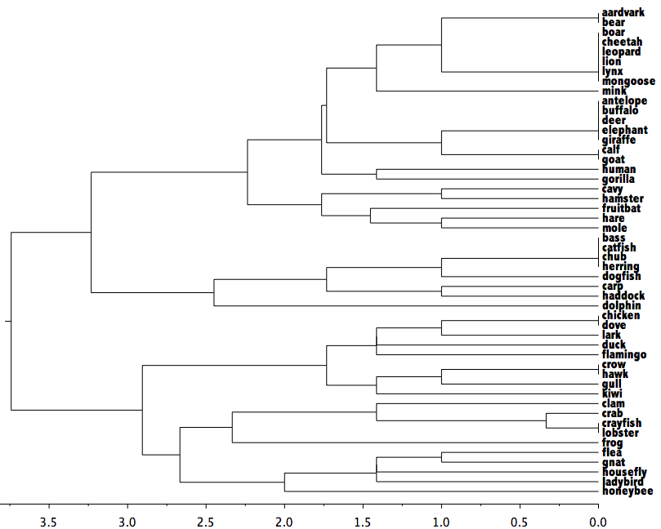
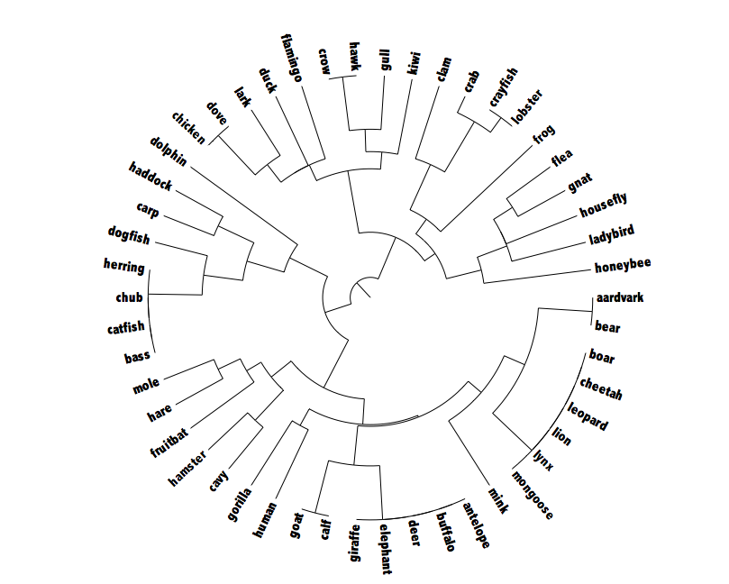
Example hierarchical clustering
50 examples of different creatures from the zoo data
Complete-linkage
Dendogram
Polar plot

Slide 137
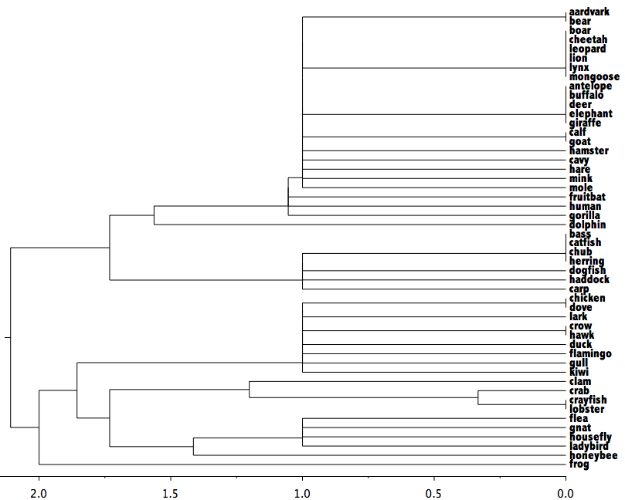
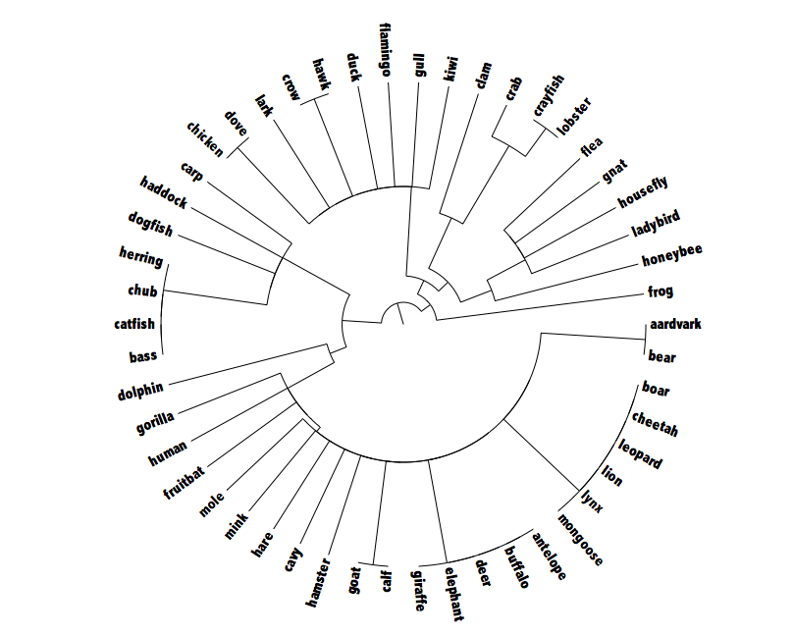
Example hierarchical clustering 2
Single-linkage

Slide 138
Incremental clustering
Heuristic approach (COBWEB/CLASSIT)
Form a hierarchy of clusters incrementally
Start:
  tree consists of empty root node
Then:
  add instances one by one
  update tree appropriately at each stage
  to update, find the right leaf for an instance
  May involve restructuring the tree
Base update decisions on category utility

Slide 139
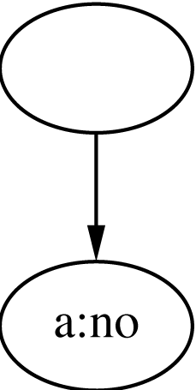
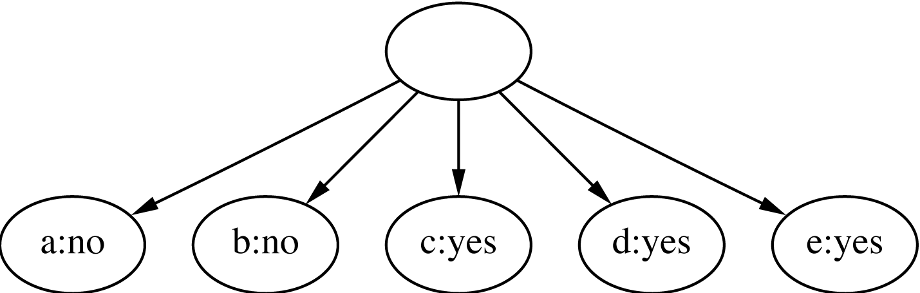
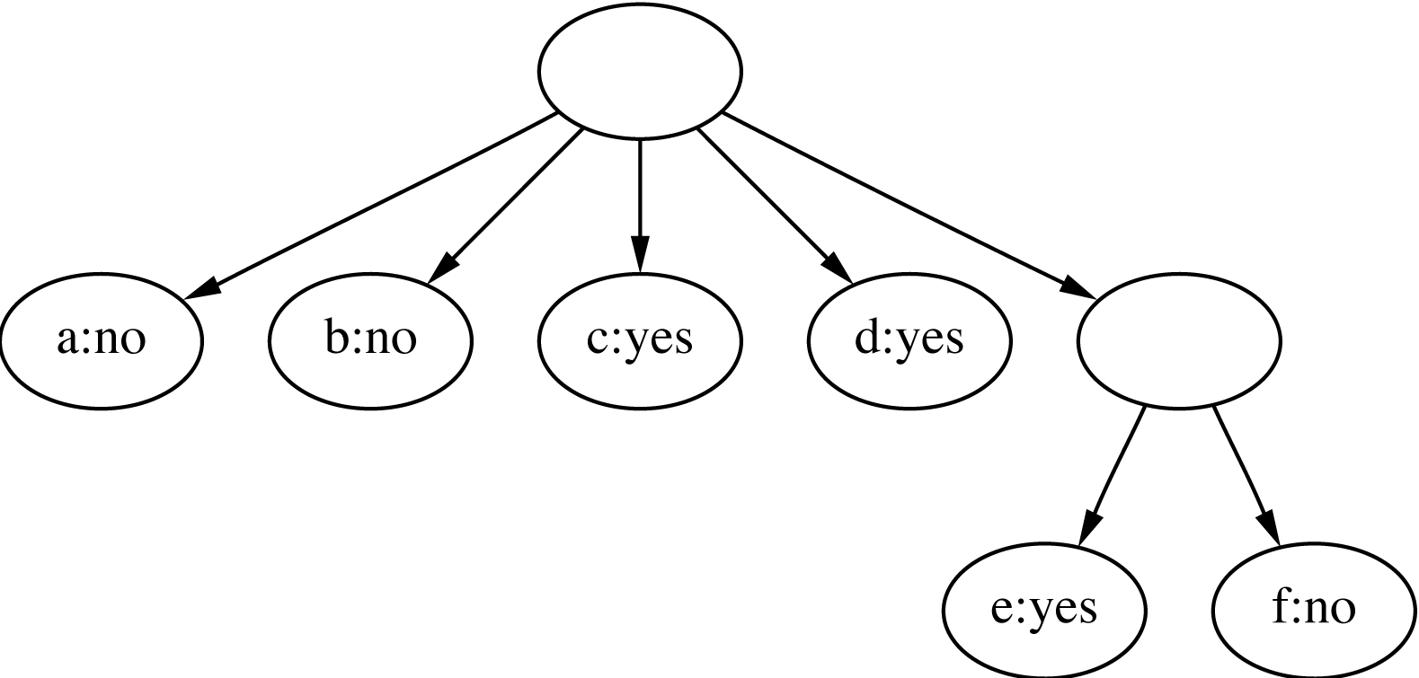
Clustering weather data
1
ID
Outlook
Temp.
Humidity
Windy
A
Sunny
Hot
High
False
B
Sunny
Hot
High
True
C
Overcast
Hot
High
False
D
Rainy
Mild
High
False
2
E
Rainy
Cool
Normal
False
F
Rainy
Cool
Normal
True
G
Overcast
Cool
Normal
True
H
Sunny
Mild
High
False
I
Sunny
Cool
Normal
False
J
Rainy
Mild
Normal
False
3
K
Sunny
Mild
Normal
True
L
Overcast
Mild
High
True
M
Overcast
Hot
Normal
False
N
Rainy
Mild
High
True

Slide 140
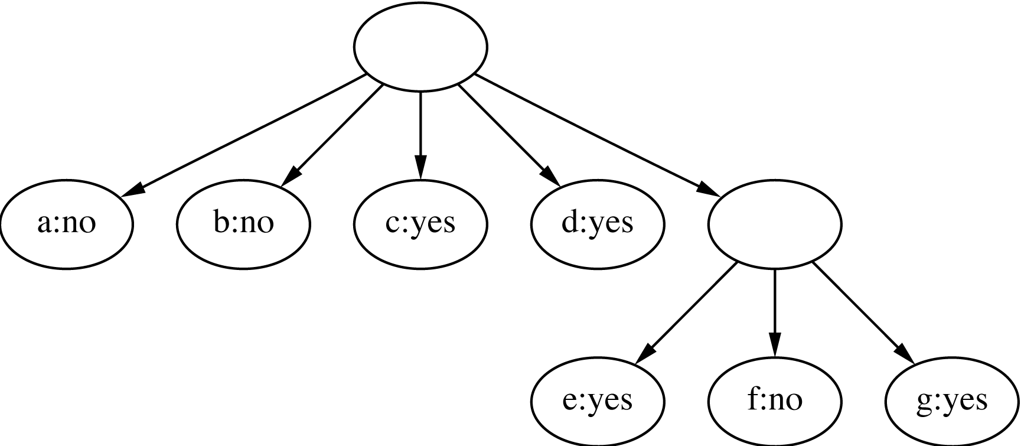
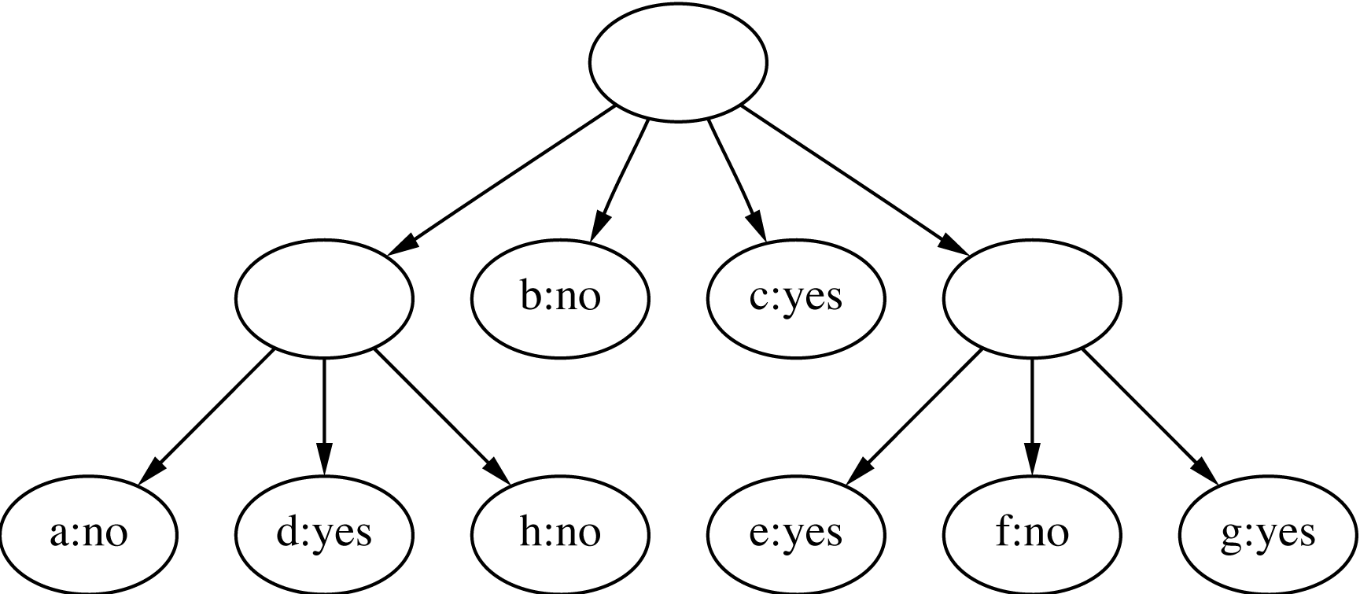
Clustering weather data
4
ID
Outlook
Temp.
Humidity
Windy
A
Sunny
Hot
High
False
B
Sunny
Hot
High
True
C
Overcast
Hot
High
False
D
Rainy
Mild
High
False
E
Rainy
Cool
Normal
False
5
F
Rainy
Cool
Normal
True
G
Overcast
Cool
Normal
True
Merge best host and runner-up
H
Sunny
Mild
High
False
I
Sunny
Cool
Normal
False
J
Rainy
Mild
Normal
False
3
K
Sunny
Mild
Normal
True
L
Overcast
Mild
High
True
M
Overcast
Hot
Normal
False
N
Rainy
Mild
High
True
Consider splitting the best host if merging doesn’t help

Slide 141
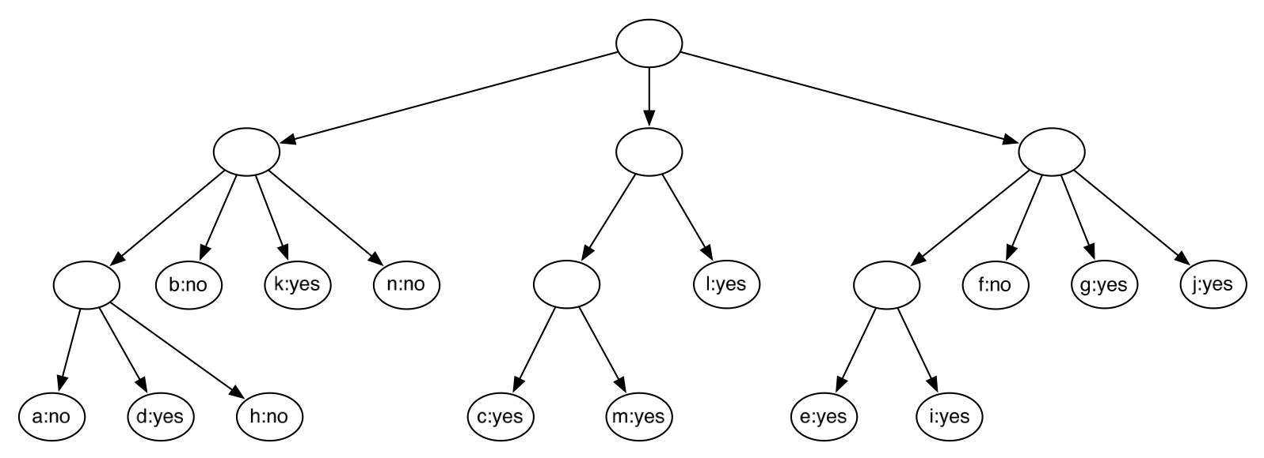
Final hierarchy

Slide 142
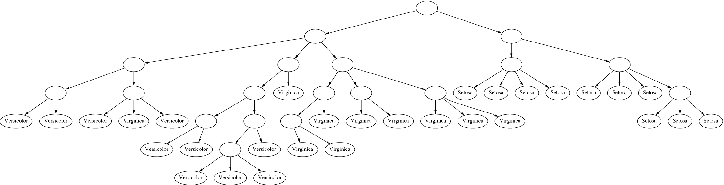
Example: the iris data (subset)

Slide 143
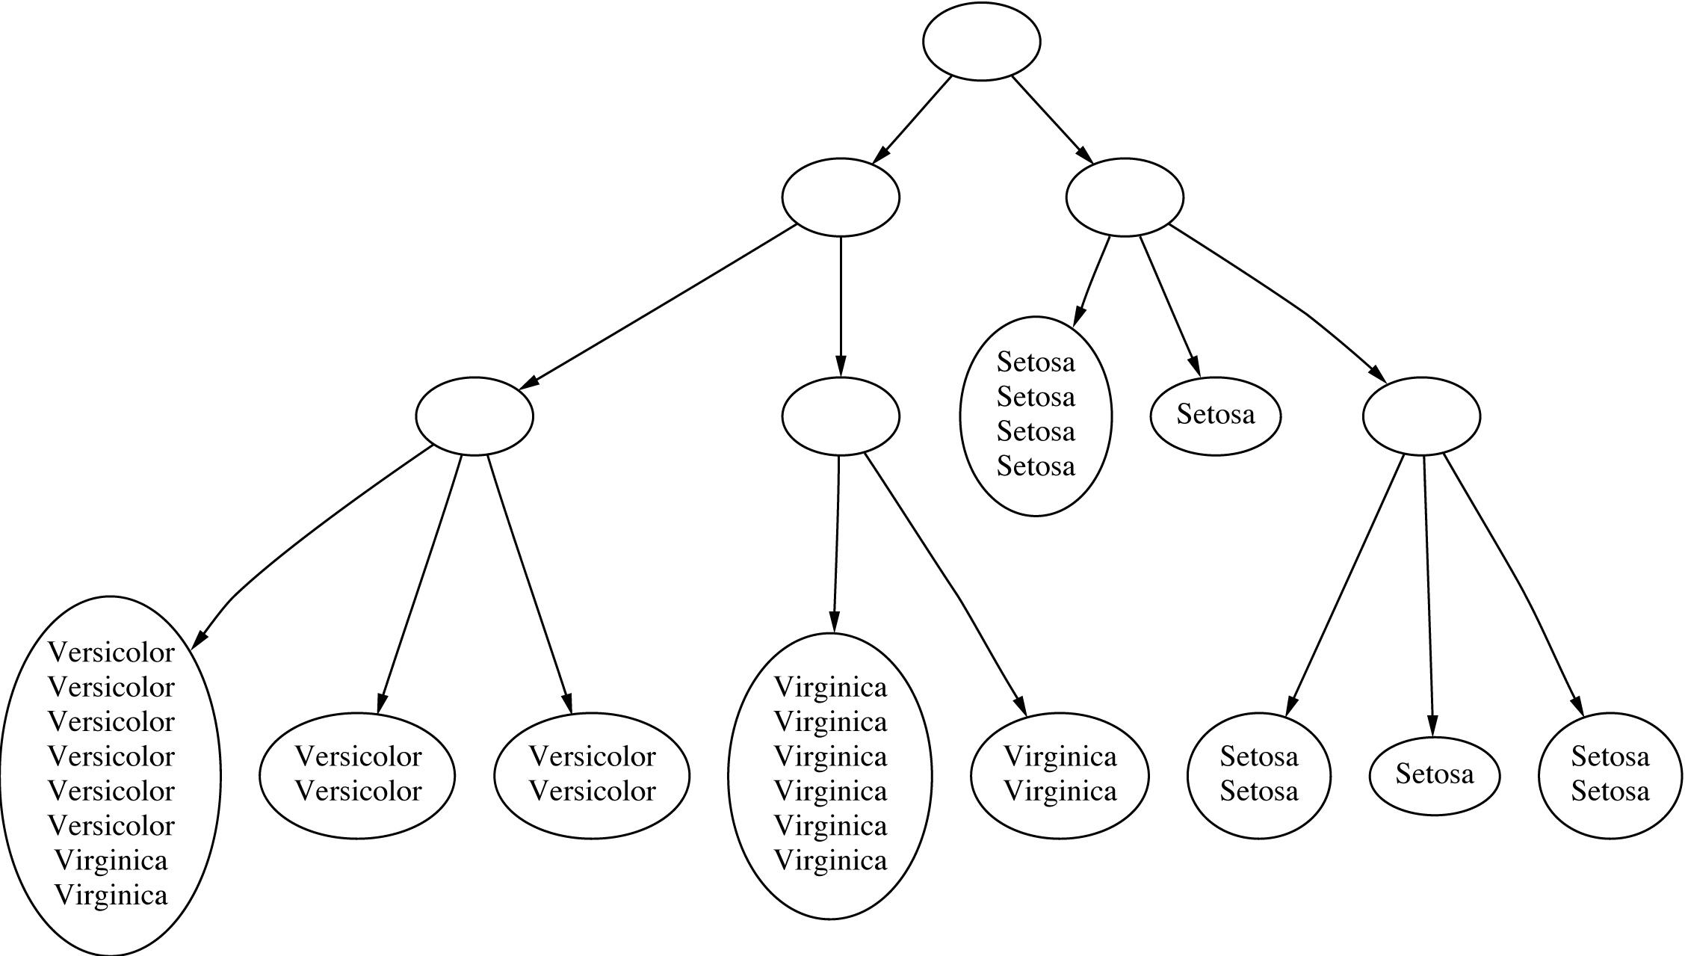
Clustering with cutoff

Slide 144
Category utility
Category utility: quadratic loss function
defined on conditional probabilities:
Every instance in different category ⇒
numerator becomes
maximum
number of attributes

Slide 145
Numeric attributes
Assume normal distribution:
Then:
Thus
becomes
Prespecified minimum variance
  acuity parameter

Slide 146
Probability-based clustering
Problems with heuristic approach:
  Division by k?
  Order of examples?
  Are restructuring operations sufficient?
  Is result at least local minimum of category utility?
Probabilistic perspective ⇒
seek the most likely clusters given the data
Also: instance belongs to a particular cluster with a certain probability

Slide 147
Finite mixtures
Model data using a mixture of distributions
One cluster, one distribution
  governs probabilities of attribute values in that cluster
Finite mixtures : finite number of clusters
Individual distributions are normal (usually)
Combine distributions using cluster weights

Slide 148
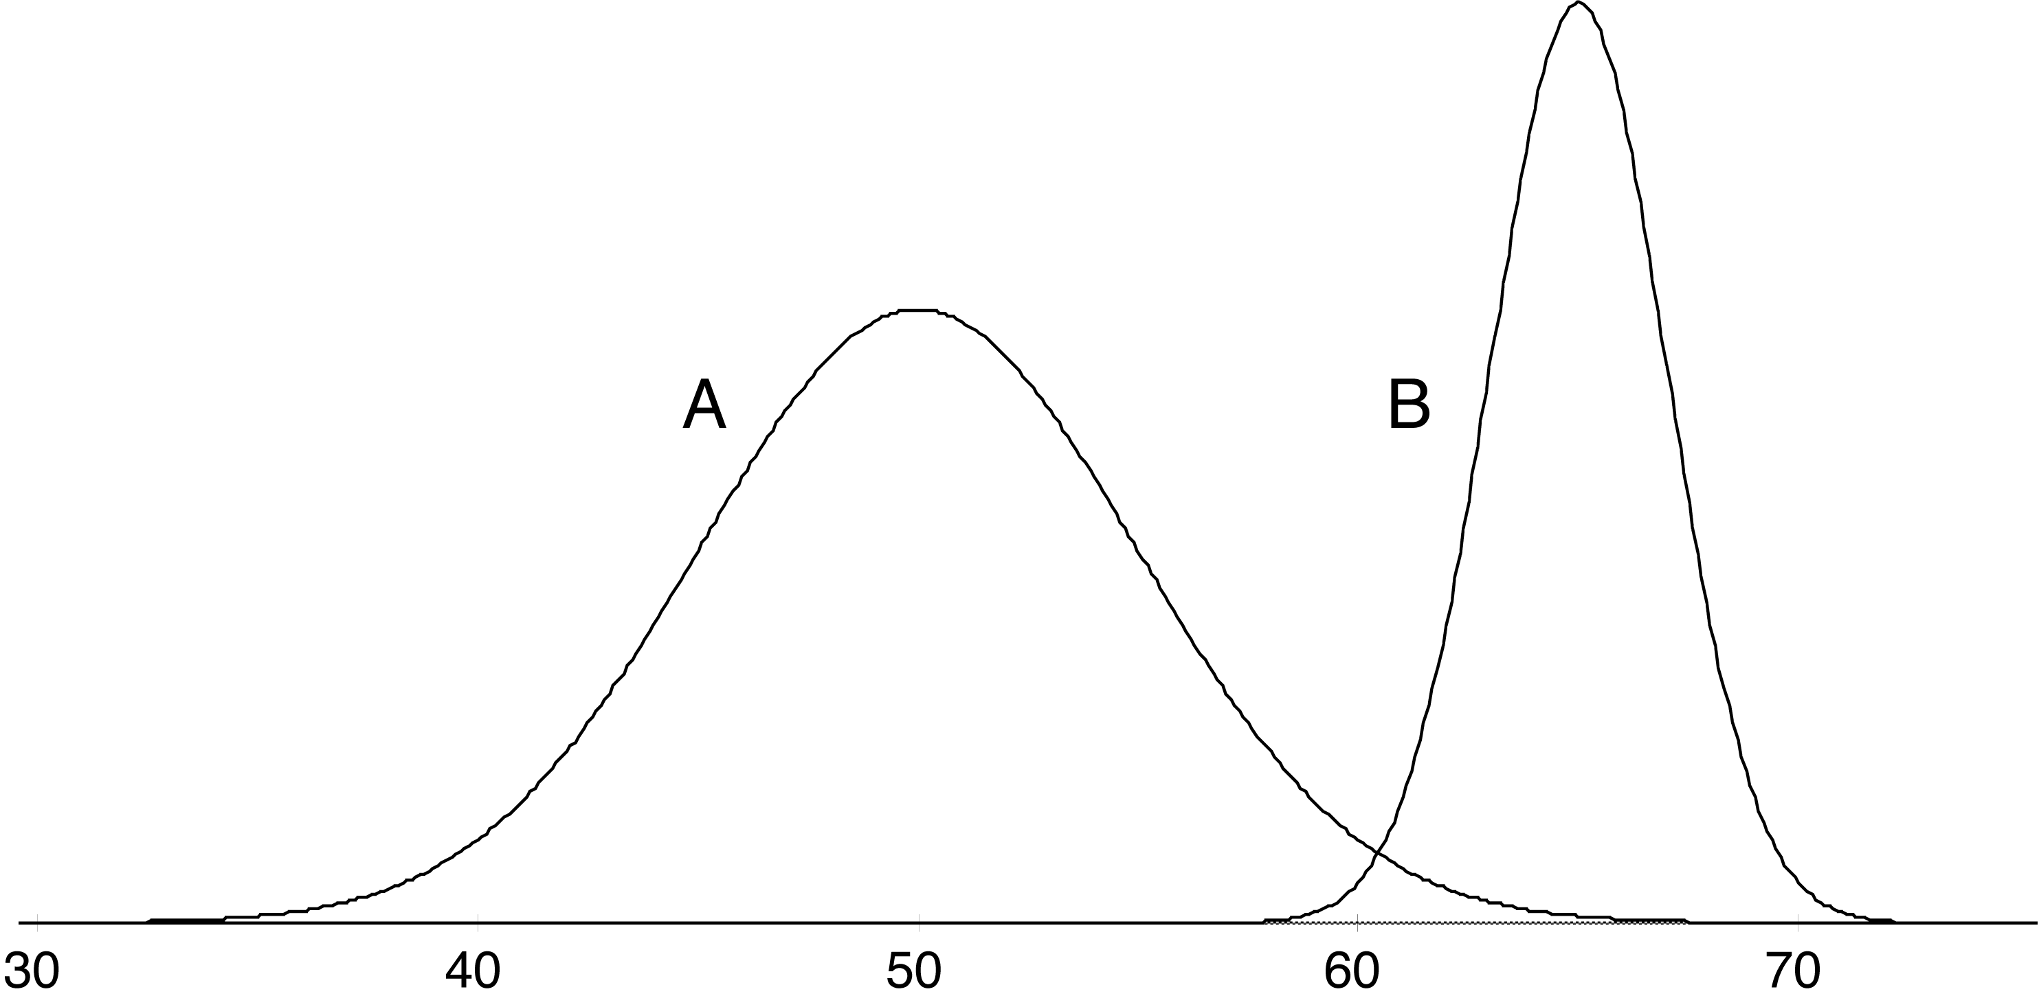
Two-class mixture model
A 51
A 43
B 62
B 64
A 45
A 42
A 46
A 45
A 45
B 62
A 47
A 52
B 64
A 51
B 65
A 48
A 49
A 46
B 64
A 51
A 52
B 62
A 49
A 48
B 62
A 43
A 40
A 48
B 64
A 51
B 63
A 43
B 65
B 66
B 65
A 46
A 39
B 62
B 64
A 52
B 63
B 64
A 48
B 64
A 48
A 51
A 48
B 64
A 42
A 48
A 41
data
model
μ_{A}=50, σ_{A} =5, p_{A}=0.6 μ_{B}=65, σ_{B} =2, p_{B}=0.4

Slide 149
Using the mixture model
Probability that instance x belongs to cluster A:
with
Probability of an instance given the clusters:

Slide 150
Learning the clusters
Assume:
  we know there are k clusters
Learn the clusters ⇒
  determine their parameters
  I.e. means and standard deviations
Performance criterion:
  probability of training data given the clusters
EM algorithm
  finds a local maximum of the likelihood

Slide 151
EM algorithm
EM = Expectation-Maximization
  Generalize k-means to probabilistic setting
Iterative procedure:
  E “expectation” step:
  Calculate cluster probability for each instance
  M “maximization” step:
  Estimate distribution parameters from cluster probabilities
Store cluster probabilities as instance weights
Stop when improvement is negligible

Slide 152
More on EM
Estimate parameters from weighted instances
Stop when log-likelihood saturates
Log-likelihood:

Slide 153
Extending the mixture model
More then two distributions: easy
Several attributes: easy—assuming independence!
Correlated attributes: difficult
  Joint model: bivariate normal distribution
  with a (symmetric) covariance matrix
  n attributes: need to estimate n + n (n+1)/2 parameters

Slide 154
More mixture model extensions
Nominal attributes: easy if independent
Correlated nominal attributes: difficult
  Two correlated attributes ⇒ v₁ v₂ parameters
Missing values: easy
Can use other distributions than normal:
  “log-normal” if predetermined minimum is given
  “log-odds” if bounded from above and below
  Poisson for attributes that are integer counts
Use cross-validation to estimate k !

Slide 155
Bayesian clustering
Problem: many parameters ⇒ EM overfits
Bayesian approach : give every parameter a prior probability distribution
  Incorporate prior into overall likelihood figure
  Penalizes introduction of parameters
Eg: Laplace estimator for nominal attributes
Can also have prior on number of clusters!
Implementation: NASA’s AUTOCLASS

Slide 156
Discussion
Can interpret clusters by using supervised learning
  post-processing step
Decrease dependence between attributes?
  pre-processing step
  E.g. use principal component analysis
Can be used to fill in missing values
Key advantage of probabilistic clustering:
  Can estimate likelihood of data
  Use it to compare different models objectively

Slide 157
Semisupervised learning
Semisupervised learning: attempts to use unlabeled data as well as labeled data
  The aim is to improve classification performance
Why try to do this? Unlabeled data is often plentiful and labeling data can be expensive
  Web mining: classifying web pages
  Text mining: identifying names in text
  Video mining: classifying people in the news
Leveraging the large pool of unlabeled examples would be very attractive

Slide 158
Clustering for classification
Idea: use naïve Bayes on labeled examples and then apply EM
  First, build naïve Bayes model on labeled data
  Second, label unlabeled data based on class probabilities (“expectation” step)
  Third, train new naïve Bayes model based on all the data (“maximization” step)
  Fourth, repeat 2nd and 3rd step until convergence
Essentially the same as EM for clustering with fixed cluster membership probabilities for labeled data and #clusters = #classes

Slide 159
Comments
Has been applied successfully to document classification
  Certain phrases are indicative of classes
  Some of these phrases occur only in the unlabeled data, some in both sets
  EM can generalize the model by taking advantage of co-occurrence of these phrases
Refinement 1: reduce weight of unlabeled data
Refinement 2: allow multiple clusters per class

Slide 160
Co-training
Method for learning from multiple views (multiple sets of attributes), eg:
  First set of attributes describes content of web page
  Second set of attributes describes links that link to the web page
Step 1: build model from each view
Step 2: use models to assign labels to unlabeled data
Step 3: select those unlabeled examples that were most confidently predicted (ideally, preserving ratio of classes)
Step 4: add those examples to the training set
Step 5: go to Step 1 until data exhausted
Assumption: views are independent

Slide 161
EM and co-training
Like EM for semisupervised learning, but view is switched in each iteration of EM
  Uses all the unlabeled data (probabilistically labeled) for training
Has also been used successfully with support vector machines
  Using logistic models fit to output of SVMs
Co-training also seems to work when views are chosen randomly!
  Why? Possibly because co-trained classifier is more robust

Slide 162
Multi-instance learning
Converting to single-instance learning
Already seen aggregation of input or output
  Simple and often work well in practice
Will fail in some situations
  Aggregating the input loses a lot of information because attributes are condensed to summary statistics individually and independently
Can a bag be converted to a single instance without discarding so much info?

Slide 163
Converting to single-instance
Can convert to single instance without losing so much info, but more attributes are needed in the “condensed” representation
Basic idea: partition the instance space into regions
  One attribute per region in the single-instance representation
Simplest case → boolean attributes
  Attribute corresponding to a region is set to true for a bag if it has at least one instance in that region

Slide 164
Converting to single-instance
Could use numeric counts instead of boolean attributes to preserve more information
Main problem: how to partition the instance space?
Simple approach → partition into equal sized hypercubes
  Only works for few dimensions
More practical → use unsupervised learning
  Take all instances from all bags (minus class labels) and cluster
  Create one attribute per cluster (region)

Slide 165
Converting to single-instance
Clustering ignores the class membership
Use a decision tree to partition the space instead
  Each leaf corresponds to one region of instance space
How to learn tree when class labels apply to entire bags?
  Aggregating the output can be used: take the bag's class label and attach it to each of its instances
  Many labels will be incorrect, however, they are only used to obtain a partitioning of the space

Slide 166
Converting to single-instance
Using decision trees yields “hard” partition boundaries
So does k-means clustering into regions, where the cluster centers (reference points) define the regions
Can make region membership “soft” by using distance – transformed into similarity – to compute attribute values in the condensed representation
  Just need a way of aggregating similarity scores between each bag and reference point into a single value – e.g. max similarity between each instance in a bag and the reference point

Slide 167
Upgrading learning algorithms
Converting to single-instance is appealing because many existing algorithms can then be applied without modification
  May not be the most efficient approach
Alternative: adapt single-instance algorithm to the multi-instance setting
  Can be achieved elegantly for for distance/similarity-based methods (e.g. nearest neighbor or SVMs)
  Compute distance/similarity between two bags of instances

Slide 168
Upgrading learning algorithms
Kernel-based methods
  Similarity must be a proper kernel function that satisfies certain mathematical properties
  One example – so called set kernel
    Given a kernel function for pairs of instances, the set kernel sums it over all pairs of instances from the two bags being compared
    Is generic and can be applied with any single-instance kernel function

Slide 169
Upgrading learning algorithms
Nearest neighbor learning
  Apply variants of the Hausdorff distance, which is defined for sets of points
  Given two bags and a distance function between pairs of instances, Hausdorff distance between the bags is
    Largest distance from any instance in one bag to its closest instance in the other bag
  Can be made more robust to outliers by using the nth-largest distance

Slide 170
Dedicated multi-instance methods
Some methods are not based directly on single-instance algorithms
One basic approach → find a single hyperrectangle that contains at least one instance from each positive bag and no instances from any negative bags
  Rectangle encloses an area of the instance space where all positive bags overlap
  Originally designed for the drug activity problem mentioned in Chapter 2
Can use other shapes – e.g hyperspheres (balls)
  Can also use boosting to build an ensemble of balls

Slide 171
Dedicated multi-instance methods
Previously described methods have hard decision boundaries – an instance either falls inside or outside a hyperectangle/ball
Other methods use probabilistic soft concept descriptions
Diverse-density
  Learns a single reference point in instance space
  Probability that an instance is positive decreases with increasing distance from the reference point

Slide 172
Dedicated multi-instance methods
Diverse-density
  Combine instance probabilities within a bag to obtain probability that bag is positive
  “noisy-OR” (probabilistic version of logical OR)
  All instance-level probabilities 0 → noisy-OR value and bag-level probability is 0
  At least one instance-level probability is → 1 the value is 1
  Diverse density, like the geometric methods, is maximized when the reference point is located in an area where positive bags overlap and no negative bags are present
    Gradient descent can be used to maximize

